Slide 1
McDonald's Corporation Account Deep Dive Analysis August 2025

Slide 2








Company Overview and Financial Summary
McDonald's is a global foodservice retailer generating revenue through company-owned restaurants, franchise royalties, and licensing pacts.
Company Overview
Year of Establishment
Headquarters
Employees
Revenue
(FY 2024)
1955
Greater Chicago Area, United States
~150,000
25920.0 USD Million
Revenue (FY 2020 - 2024)
Revenue share by Segments (FY 2024)
Revenue CAGR
(FY 2020 - 2024)
Financial
Snapshot
7.78%
Revenue in USD Million

Slide 3
Account Priorities: Sales & Marketing
Business Function | Account Priority | Applicable Use Cases | Workloads
Sales & Marketing | Executing High-Impact Marketing Campaigns | • Data-driven Movie Marketing Campaign • Cross-Channel Advertising Platform • IoT-enabled Hyper-Targeted Marketing Campaigns | • Marketing Strategy & Brand Management • Digital Marketing • Offline Marketing
 | McDonald's is launching significant marketing campaigns, such as the partnership with The Minecraft Movie, to engage customers and drive traffic. These campaigns aim to create memorable experiences and strengthen brand loyalty. The company is amplifying its marketing efforts to drive traffic and enhance brand strength through culturally relevant campaigns. By leveraging digital and traditional marketing strategies, McDonald's aims to connect with...
Sales & Marketing | Strategic Leadership Enhancement in Global Brand Marketing | • Data-driven Brand Positioning • AI-powered Virtual Agent for Marketing • Cross-Channel Advertising Platform | • Marketing Strategy & Brand Management • Digital Marketing • Business Development
 | McDonald's has strengthened its global marketing leadership by appointing Paloma Azulay as Vice President of Global Brand Marketing, reporting to the EVP and Global Chief Marketing Officer. Azulay brings extensive experience from leading brand roles at Hulu and Restaurant Brands International. This leadership move aims to drive cohesive global brand strategies, enhance marketing effectiveness, and support new business ventures.
Sales & Marketing | Customer Engagement through Limited-Edition Collaborations and Digital Experiences | • Data-driven Brand Positioning • Targeted Cross Selling & Up Selling using AI • Wearable Banking | • Marketing Strategy & Brand Management • Account Management • Business Development
 | McDonald's is leveraging brand collaborations and digital engagement to deepen customer connections. Examples include limited-edition collectible charms with Tokidoki in Singapore and the launch of Lil McDonalds Happy Meals featuring mini toys and a digital game experience. These initiatives are designed to create memorable brand interactions, especially targeting families and younger demographics, thereby strengthening brand loyalty.
Note: The mentioned data are not exhaustive

Slide 4
Account Priorities: Sales & Marketing
Business Function | Account Priority | Applicable Use Cases | Workloads
Sales & Marketing | Value Menu Expansion with Affordable Meal Deals | • Ancillary Price Optimization using AI • AI-enabled Restaurant Promotions • AI-powered Personalized Pricing Platform | • Pricing • Business Development • Marketing Strategy & Brand Management
 | To address consumer price sensitivity and drive traffic, McDonald's is expanding its value offerings with an under $4 McValue Menu at select U.S. locations and introducing the Daily Double Burger as a new entrée option within the Meal Deal special. These pricing strategies aim to provide customers with more affordable choices while maintaining menu appeal and competitive positioning.
Sales & Marketing | Integrated Marketing Campaigns | • AI-enabled Restaurant Promotions • Campaign Management Automation using AI • AI-powered Campaign Optimization | • Marketing Strategy & Brand Management • Offline Marketing • Inside Sales
 | McDonald's has launched an integrated campaign for limited edition meals tied to local sports events, targeting specific regional audiences. This campaign utilizes various media channels to engage customers and promote brand loyalty through localized marketing efforts.
Sales & Marketing | Partnership with Gaming Culture | • Blockchain-based Game Rewards • Omnichannel Communication Platform • VR-based Live Event Streaming | • Marketing Strategy & Brand Management • Communication & Public Relation • Event Management
 | McDonald's UK has partnered with esports organization Fnatic to engage with gaming culture, launching promotional events and products. This initiative aims to connect with younger audiences and enhance brand visibility within the gaming community.
Note: The mentioned data are not exhaustive

Slide 5
Account Priorities: Sales & Marketing
Business Function | Account Priority | Applicable Use Cases | Workloads
Sales & Marketing | Innovative Marketing Campaigns for Brand Engagement | • IoT-enabled Hyper-Targeted Marketing Campaigns • Cloud-based Sales Targeting and Campaign Personalization • Automated Marketing Campaigns | • Marketing Strategy & Brand Management • Digital Marketing • Sales Strategy & Planning
 | McDonald's is prioritizing innovative marketing campaigns that resonate with diverse customer segments. This includes collaborations with popular franchises and limited-time offers. The goal is to enhance brand visibility and attract new customers through creative promotions.
Sales & Marketing | Limited-Time Offerings for Seasonal Promotions | • AI-enabled Restaurant Promotions • Digital Billboards • Quantum-powered Advertising Optimization | • Offline Marketing • Marketing Strategy & Brand Management • Sales Enablement & Support
 | McDonald's is launching limited-time offerings, such as the Shamrock Shake and Teritama Family, to attract seasonal customers. These promotions aim to leverage nostalgia and seasonal flavors to drive sales.
Sales & Marketing | Targeted Marketing Campaigns for New Product Lines | • IoT-enabled Hyper-Targeted Marketing Campaigns • Smart Cans for Personalized Marketing • ML-based Product Promotion Optimization | • Marketing Strategy & Brand Management • Digital Marketing • Field & Channel Sales
 | The company is implementing targeted marketing campaigns for new product lines, including the Hot Honey range and Minecraft-themed meals. These campaigns are designed to engage specific demographics and enhance brand visibility.
Note: The mentioned data are not exhaustive

Slide 6
Account Priorities: Human Resources
Business Function | Account Priority | Applicable Use Cases | Workloads
Human Resources | Fostering Employee Engagement and Development | • Employee Engagement App • Real-time Employee Experience Management • AI-powered Employee Engagement | • Employee Relation, Engagement & Retention • Learning & Development • HR Strategy & Governance
 | McDonald's is focused on creating an inclusive environment that excites employees and encourages retention. This involves aligning HR practices with organizational objectives to enhance workforce performance. The company is dedicated to fostering a positive work environment and enhancing employee performance through engagement and development initiatives. McDonald's has successfully reduced barriers to employment for millions of young people thro...
Human Resources | Mass Recruitment Initiative | • High-Volume Hiring using AI • Automated Employee Hiring • Metaverse-based Recruitment and Hiring | • Talent Acquisition • Employee Relation, Engagement & Retention • Workforce Administration & Management
 | McDonald's plans to hire up to 375,000 workers across its U.S. restaurants this summer, marking one of its largest recruitment efforts in five years. This initiative aims to staff new locations and support existing operations, providing job opportunities and career development through programs like Archways to Opportunity.
Human Resources | Youth Employment Focus | • Automated Employee Hiring • Metaverse-based Recruitment and Hiring • AI based Talent Acquisition | • Talent Acquisition • Employee Relation, Engagement & Retention • HR Strategy & Governance
 | McDonald's Turkey is launching a recruitment campaign to hire 2,000 people, particularly targeting younger demographics to reduce unemployment rates. The initiative emphasizes flexible working models and aims to support workforce participation among various age groups.
Note: The mentioned data are not exhaustive

Slide 7
Account Priorities: Human Resources
Business Function | Account Priority | Applicable Use Cases | Workloads
Human Resources | Leadership in HR Transformation | • AI-powered Job Restructuring Model • Generative AI-based HR Workflow Management • AI-based HCM Solution | • HR Strategy & Governance • HRIS & Analytics • Workforce Administration & Management
 | McDonald's South Africa appointed Dr. Mamello Masia as Chief People Officer to enhance workforce transformation and operational resilience. Her extensive HR leadership experience will drive the introduction of modern HR systems and digital HR innovation.
Human Resources | Developing a Diverse and Inclusive Workforce | • AI-driven Hospitality Employee Training • AI-powered Employee Retention • Digital Badges for Employees | • Employee Relation, Engagement & Retention • HR Strategy & Governance • Learning & Development
 | McDonald's is committed to fostering a diverse and inclusive workplace. This includes implementing recruitment strategies that attract a wide range of talent and promoting an inclusive culture. The focus is on enhancing employee engagement and retention through various development programs.
Human Resources | Microcredential Program for Employee Development | • Digital Badges for Employees • AI-driven Hospitality Employee Training • VR-based Employee Training | • Learning & Development • Employee Relation, Engagement & Retention • Compensation & Benefits
 | McDonald's is launching a microcredential program to recognize employees' skills acquired on the job. This initiative aims to enhance employee development and align with the company's commitment to workforce growth.
Note: The mentioned data are not exhaustive

Slide 8
Account Priorities: Human Resources
Business Function | Account Priority | Applicable Use Cases | Workloads
Human Resources | Strengthening Leadership through Strategic Appointments | • AI-powered Job Restructuring Model • ML-powered Workforce Management • Voice Assistant App For Employees | • Employee Relation, Engagement & Retention • Workforce Administration & Management • HR Strategy & Governance
 | McDonald's has appointed Jill McDonald as president of its international operated markets, aiming to enhance leadership and strategic direction across global operations. This leadership change is part of a broader strategy to improve market performance and adapt to evolving consumer preferences.
Human Resources | Revising Diversity and Inclusion Strategies | • Generative AI-based HR Workflow Management • Employee Engagement App • Real-time Employee Experience Management | • HR Strategy & Governance • Learning & Development • Employee Relation, Engagement & Retention
 | Following a civil rights audit, McDonald's is modifying its diversity, equity, and inclusion practices to focus on a more integrated approach. The rebranding of the diversity team to the Global Inclusion Team reflects a commitment to fostering a respectful workplace.
Human Resources | Expanding Workforce Opportunities | • e-Rostering • AI-powered Workforce Scheduling • ML-powered Workforce Management | • Talent Acquisition • Employee Relation, Engagement & Retention • Workforce Administration & Management
 | McDonald's is actively seeking to fill job openings across various functions, emphasizing the creation of part-time and full-time positions. This initiative aims to strengthen the workforce and enhance operational efficiency.
Note: The mentioned data are not exhaustive

Slide 9
Account Priorities: Management & Strategy
Business Function | Account Priority | Applicable Use Cases | Workloads
Management & Strategy | Executing the Accelerating the Arches Strategy | • Data-driven Strategic Market Expansion • AI-driven Capital Investment Optimization • AI-based Government Contract Optimization | • Corporate Strategy & Management Consulting • Leadership & Governance • Governance, Risk & Compliance
 | McDonald's is committed to executing its 'Accelerating the Arches' strategy, which focuses on leadership in value, menu innovation, and enhancing customer experiences. This strategic direction aims to drive guest count growth and improve market share by leveraging competitive advantages and responding to customer insights. The strategy includes enhancing value offerings and leveraging marketing to drive customer engagement. By focusing on sustain...
Management & Strategy | Leadership Development through Cross-Functional Role Rotation | • Data-driven Strategic Market Expansion • Cloud-based Product Lifecycle Management • Digital Twins for Product Design and Development | • Corporate Strategy & Management Consulting • Leadership & Governance • Product Management
 | McDonald's is advancing its leadership development strategy by rotating senior executives within its technology division to broaden their market and functional expertise. This approach supports long-term organizational transformation goals by cultivating versatile leaders capable of driving innovation and strategic initiatives across business functions.
Management & Strategy | Global Expansion Strategy | • Data-driven Strategic Market Expansion • AI-based Sustainable Logistics Optimization • AI-driven Capital Investment Optimization | • Corporate Strategy & Management Consulting • Leadership & Governance • Corporate Social Responsibility
 | McDonald's aims to expand its global footprint to over 50,000 restaurants by 2027, with a focus on opening 900 new locations in the U.S. This ambitious growth plan is part of a broader strategy to reinforce the company's market dominance.
Note: The mentioned data are not exhaustive

Slide 10
Account Priorities: Management & Strategy
Business Function | Account Priority | Applicable Use Cases | Workloads
Management & Strategy | Menu Innovation and Refresh | • AR-based Product Customization • Generative AI-based Product Lifecycle Management • Data-driven Strategic Market Expansion | • Corporate Strategy & Management Consulting • Product Management • Corporate Social Responsibility
 | The company is continuously innovating its menu with new and returning items, such as the Breakfast Saver Menu and seasonal offerings. These initiatives are designed to attract customers and enhance the dining experience, particularly during peak seasons.
Management & Strategy | Driving Sustainable Growth through Strategic Partnerships | • Data-driven Strategic Market Expansion • AI-based Sustainable Logistics Optimization • AI-based Sustainable Energy Transition | • Corporate Strategy & Management Consulting • Corporate Social Responsibility • Leadership & Governance
 | McDonald's is focusing on forming strategic partnerships to drive sustainable growth. This includes collaborations with local suppliers and community organizations. The aim is to enhance brand reputation and expand market reach while supporting local economies.
Management & Strategy | Revamping Operations for Faster Innovation | • Data-driven Strategic Market Expansion • AR-based Product Customization • Digital Twins for Product Design and Development | • Corporate Strategy & Management Consulting • Product Management • Leadership & Governance
 | McDonald's is overhauling its operations to expedite the introduction of new menu items and technology. This strategic shift aims to regain market traction and enhance coordination with restaurants.
Note: The mentioned data are not exhaustive

Slide 11
Account Priorities: Management & Strategy
Business Function | Account Priority | Applicable Use Cases | Workloads
Management & Strategy | Establishment of Global Category Management Teams | • Data-driven Strategic Market Expansion • Generative AI-based Product Lifecycle Management • Cloud-based Product Lifecycle Management | • Corporate Strategy & Management Consulting • Product Management • Leadership & Governance
 | The company is creating dedicated global category management teams for beef, chicken, and beverages/desserts. This initiative is designed to solidify McDonald's market position and enhance focus on key product categories.
Management & Strategy | Strategic Insights for Market Adaptation | • Data-driven Strategic Market Expansion • AI-driven Capital Investment Optimization • Automated Supplier Risk Assessment | • Corporate Strategy & Management Consulting • Leadership & Governance • Governance, Risk & Compliance
 | McDonald's USA has announced new leadership in Strategic Insights and Prioritization to better align business strategies with market demands. This initiative is focused on enhancing decision-making processes to adapt to changing consumer behaviors and preferences.
Management & Strategy | Strategic Growth through Franchise Partnerships | • Data-driven Strategic Market Expansion • AI-based Sustainable Logistics Optimization • AI-based Government Contract Optimization | • Corporate Strategy & Management Consulting • Corporate Social Responsibility • Leadership & Governance
 | McDonald's has renewed its Master Franchise Agreement with Arcos Dorados, focusing on expanding its footprint in Latin America. This strategic partnership aims to positively impact local communities and drive growth in the region.
Note: The mentioned data are not exhaustive

Slide 12
Account Priorities: Retail Operations
Business Function | Account Priority | Applicable Use Cases | Workloads
Retail Operations | Optimizing Retail Experience Across Channels | • Digital Experience Management for E-Commerce Sites • Digital Catalogue • Digital Twin-enabled Retail Stores | • Category Management • E-Commerce Operations • Retail Store Operations
 | McDonald's is enhancing its retail operations by focusing on both physical and digital platforms to provide a seamless shopping experience. This includes category management, product assortment, and e-commerce strategies to drive sales. The company is dedicated to optimizing retail operations by improving product assortment, pricing strategies, and e-commerce capabilities. By creating a seamless shopping experience for customers, both in-store an...
Retail Operations | Enhanced Late-Night Operations | • Video Chat Food Ordering Kiosk • In-store Navigation App • Self-checkout | • Retail Store Operations • E-Commerce Operations • Category Management
 | McDonald's is expanding its late-night hours at many locations, allowing for a broader menu availability during these hours. This initiative aims to capture additional customer traffic during peak late-night periods, particularly in urban areas.
Retail Operations | Enhancing In-Store Experience and Efficiency | • In-store Navigation App • Digital Twin-enabled Retail Stores • Digital Catalogue | • Retail Store Operations • Category Management • E-Commerce Operations
 | McDonald's is focusing on improving the in-store experience for customers through layout redesigns and operational efficiency enhancements. This initiative aims to create a more inviting atmosphere while ensuring quick service and product availability.
Note: The mentioned data are not exhaustive

Slide 13
Account Priorities: Retail Operations
Business Function | Account Priority | Applicable Use Cases | Workloads
Retail Operations | Launch of Collectors Meals | • AI-enabled Digital Menu Displays • Click and Collect • App-based Beverage Delivery | • Merchandising • Category Management • E-Commerce Operations
 | McDonald's is introducing Collectors Meals, a special edition combo meal that includes unique collectible cups. This initiative aims to rekindle nostalgia and attract both new and returning customers.
Retail Operations | Expansion of Drive-Thru Locations | • Video Chat Food Ordering Kiosk • Automated Drive-through payments • Customer Information Database Automation in Stores | • Retail Store Operations • Category Management • E-Commerce Operations
 | McDonald's is expanding its drive-thru locations to enhance customer convenience and service. This initiative is expected to create new job opportunities and improve operational efficiency.
Retail Operations | Menu Innovation to Drive Sales | • AI-enabled Digital Menu Displays • App-based Beverage Delivery • Smart Visual Merchandising | • Category Management • Merchandising • E-Commerce Operations
 | McDonald's is introducing limited-time menu items like the Sweetie Pie Bliss and McSpicy chicken sandwich to attract customers and boost sales. These new offerings are designed to create excitement and encourage repeat visits from customers seeking unique dining experiences.
Note: The mentioned data are not exhaustive

Slide 14
Account Priorities: Retail Operations
Business Function | Account Priority | Applicable Use Cases | Workloads
Retail Operations | Collaborative Promotions for Customer Attraction | • Click and Collect • QR Code-enabled Shopping • Digital Coupons | • Category Management • Merchandising • E-Commerce Operations
 | The partnership with Urban Point in Qatar allows McDonald's to offer popular menu items through buy-one-get-one-free promotions, enhancing customer value. This collaboration aims to increase foot traffic and customer loyalty by providing attractive savings on beloved menu items.
Retail Operations | Innovating Retail Experience through New Concepts | • Digital Retail App • In-store Navigation App • Self-checkout | • Category Management • Retail Store Operations • E-Commerce Operations
 | McDonald's is set to open new restaurants in collaboration with Certas Energy Norway, enhancing its presence along road networks. This initiative aligns with the company's growth ambitions and aims to improve customer accessibility.
Retail Operations | Seasonal Menu Innovations | • AI-enabled Digital Menu Displays • Video Chat Food Ordering Kiosk • Shopping List Suggestion by Smart Refrigerator | • Category Management • Merchandising • Retail Store Operations
 | McDonald's is launching festive menu items, such as The Grinch Meal, to enhance customer engagement during the holiday season. These limited-time offerings include unique food combinations and themed merchandise to create a memorable dining experience.
Note: The mentioned data are not exhaustive

Slide 15
Account Priorities: ER&D
Business Function | Account Priority | Applicable Use Cases | Workloads
ER&D | Accelerating Menu Innovation and Technology Integration | • Generative AI-based Personalized Culinary Experience • AI-based Personalized Dining Experience • Automated Restaurant Kitchen Management | • Artificial Intelligence & Data Science • Robotic Process Automation • Augmented Reality & Virtual Reality
 | McDonald's is expediting the introduction of innovative menu items through the establishment of a global restaurant experience team, which integrates product development with operations and supply chain. This initiative aims to enhance the overall dining experience by scaling successful products quickly. Concurrently, the company is focusing on tech innovations such as IoT-enabled restaurant equipment and Google Cloud connectivity to improve oper...
ER&D | Innovating Menu Offerings with Sustainable Ingredients | • Generative AI-based Personalized Culinary Experience • Flavor Creation using AI • AI-driven Supplier Sustainability Evaluation | • Artificial Intelligence & Data Science • Robotic Process Automation • Application Development & Maintenance
 | McDonald's is committed to enhancing its menu by incorporating sustainable and locally sourced ingredients. This initiative aims to improve product quality while addressing environmental concerns. The focus is on developing new items that appeal to health-conscious consumers and align with sustainability goals.
ER&D | Integration of AI-Driven Tools | • Predictive Food Preparation using AI • AI-assisted Cooking Robot • Automated Restaurant Kitchen Management | • Artificial Intelligence & Data Science • Robotic Process Automation • Internet of Things
 | McDonald's is enhancing its operational efficiency by integrating AI-driven tools and internet-connected kitchen equipment. This initiative aims to improve order accuracy, predict equipment failures, and support AI-powered drive-throughs.
Note: The mentioned data are not exhaustive

Slide 16
Account Priorities: ER&D
Business Function | Account Priority | Applicable Use Cases | Workloads
ER&D | Leveraging AI for Operational Efficiency | • AI-powered Accounting Solution at Restaurants • AI-enabled Smart Restaurant • AI-based Personalized Dining Experience | • Artificial Intelligence & Data Science • Robotic Process Automation • Cloud Computing
 | McDonald's has extended its partnership with Cognizant to utilize AI-driven solutions like Skygrade and Neuro IT, aimed at streamlining IT functions and enhancing cloud management. This strategic move is designed to simplify the technology landscape, making it more cohesive and efficient for both customers and restaurant operations.
ER&D | Sustainable Packaging Innovations | • AI/ML-based Sustainability Optimization • AI-enabled Sorting Machines for Plastic Recycling • ML-based Sustainable Procurement Optimization | • Robotic Process Automation • Artificial Intelligence & Data Science • Internet of Things
 | McDonald's Finland is proactively reducing plastic usage by introducing fiber-based lids for beverages, ahead of its 2025 sustainability goals. This initiative is expected to significantly lower plastic consumption and carbon emissions, demonstrating McDonald's commitment to environmental sustainability.
ER&D | Sustainable Feed Innovations for Meat Production | • Food Chain Optimization using AI • AI-based Breeding using Genome Editing • AI/ML-based Sustainability Optimization | • Artificial Intelligence & Data Science • Robotic Process Automation • Internet of Things
 | McDonald's is collaborating with Syngenta to scale the use of Enogen corn as animal feed, targeting a reduction in greenhouse gas emissions. This initiative aims to improve feed efficiency and promote sustainable practices within the supply chain.
Note: The mentioned data are not exhaustive

Slide 17
Account Priorities: ER&D
Business Function | Account Priority | Applicable Use Cases | Workloads
ER&D | Sustainable Beef Production Initiative | • Food Chain Optimization using AI • AI/ML-based Sustainability Optimization • AI-driven Supplier Sustainability Evaluation | • Artificial Intelligence & Data Science • Robotic Process Automation • Internet of Things
 | McDonald's is collaborating with Lopez Foods and Syngenta to enhance the sustainability of beef production. This initiative focuses on improving feed efficiency and reducing greenhouse gas emissions in livestock production systems.
ER&D | Innovating Menu Offerings with Plant-Based Options | • Generative AI-based Personalized Culinary Experience • AI-based Personalized Dining Experience • AI-enabled Digital Menu Displays | • Artificial Intelligence & Data Science • Robotic Process Automation • Data Engineering
 | McDonald's is expanding its menu to include plant-based items, such as the Veggie McPlant Nuggets, to cater to the growing demand for vegetarian and vegan options. This initiative aims to attract a broader customer base while promoting sustainability.
ER&D | Innovating Menu Offerings with Gourmet Options | • Generative AI-based Personalized Culinary Experience • AI-based Personalized Dining Experience • Generative AI-powered Personalized Recipe Creation | • Robotic Process Automation • UI/UX Design • Artificial Intelligence & Data Science
 | The launch of the Signature Collection aims to introduce gourmet burgers that cater to the premium segment, enhancing McDonald's menu diversity. This initiative focuses on culinary sophistication and quality, setting new benchmarks in the quick-service restaurant industry.
Note: The mentioned data are not exhaustive

Slide 18
Account Priorities: IT
Business Function | Account Priority | Applicable Use Cases | Workloads
IT | Enhancing Digital Solutions and Transformation | • AI-powered Accounting Solution at Restaurants • Data-driven Customer Support Optimization • Automated Restaurant Kitchen Management | • IT Consulting • Artificial Intelligence & Data Science • Robotic Process Automation
 | McDonald's IT function is prioritizing the development and management of digital solutions that drive operational efficiency and improve customer experiences. Key areas include application development, cybersecurity, and data analytics to support decision-making. The company is investing in strategic technology platforms to enhance operational efficiency and customer engagement, aiming to achieve 250 million active loyalty users and $45 billion i...
IT | Leadership Realignment to Accelerate Digital and Technology Transformation | • AI-powered Job Restructuring Model • AI-driven Sales Targeting • AI-based Data Virtualization | • IT Consulting • Legacy Modernization • Artificial Intelligence & Data Science
 | McDonald's is executing a leadership rotation within its U.S. technology division, with Valerie Ashbaugh appointed as Chief Information Officer and Whitney McGinnis moving to Senior Vice President, Commercial Products and Platforms. This strategic move aims to broaden leadership impact, foster cross-functional perspectives, and support the company’s ongoing digital transformation and technology innovation efforts.
IT | Enhancement of Digital Payment Infrastructure through Strategic Partnerships | • AI-powered UPI Payments • AI-based Payment Processing • Facial Recognition-enabled Payment Systems | • IT Consulting • System Integration • Artificial Intelligence & Data Science
 | McDonald's has partnered with AsiaPay to deploy an integrated online payment solution in Taiwan, incorporating multiple payment options such as credit cards, mobile payments, and popular e-wallets. This collaboration is part of McDonald's broader digital transformation strategy to provide faster, more secure, and frictionless transaction experiences, enhancing customer convenience and operational efficiency.
Note: The mentioned data are not exhaustive

Slide 19
Account Priorities: IT
Business Function | Account Priority | Applicable Use Cases | Workloads
IT | Implementing Advanced Digital Solutions | • Data-driven Customer Support Optimization • Data-driven Customer Insights Platform • AI-powered Sales Enablement | • Artificial Intelligence & Data Science • Mobile Application Development • Application Development & Maintenance
 | McDonald's is investing in advanced digital solutions to streamline operations and enhance customer interactions. This includes the development of mobile applications and data analytics tools. The goal is to leverage technology for better decision-making and operational efficiency.
IT | Digital Transformation for Enhanced Customer Experience | • AI-enabled Smart Restaurant • AI-driven Kiosks at Restaurants • Generative AI-based Personalized Culinary Experience | • Data Centre Management • Artificial Intelligence & Data Science • IT Consulting
 | The appointment of Atif Rafiq as the first chief digital officer signifies McDonald's commitment to modernizing its digital strategy and enhancing consumer engagement. This role will focus on leveraging digital marketing and e-commerce to drive growth and improve the overall restaurant experience.
IT | Cloud Solutions for Operational Excellence | • Cloud based Supply Chain Management • Cloud-based Wholesale Management • Cloud-based Supply Chain Resilience | • Cloud Computing • Data Centre Management • Artificial Intelligence & Data Science
 | McDonald's collaboration with Tencent Cloud aims to bolster operational efficiency and enhance digital ordering systems in China. This partnership will facilitate smarter store location selection and improve service management during peak times.
Note: The mentioned data are not exhaustive

Slide 20
Account Priorities: IT
Business Function | Account Priority | Applicable Use Cases | Workloads
IT | Leveraging AI for Enhanced Operational Efficiency | • AI-powered Expense Management • AI-powered Sales Enablement • AI-based Collateral Management | • Artificial Intelligence & Data Science • IT Consulting • Robotic Process Automation
 | McDonald's is extending its partnership with Cognizant to utilize AI solutions in global finance systems and human capital management. This initiative aims to streamline processes and improve data management across the organization.
IT | Enhancement of Mobile App Features | • App-based Customer Loyalty Program • Mobile App for Customer Support • Mobile App Monetization | • Mobile Application Development • Application Development & Maintenance • Artificial Intelligence & Data Science
 | McDonald's is focusing on improving its mobile app functionalities to enhance customer engagement and streamline ordering processes. This includes exclusive offers and promotions available through the app.
IT | Advancing Digital Infrastructure for Operational Efficiency | • Data-driven Customer Support Optimization • AI-enabled Customer Service • AI-optimized Data Center Infrastructure | • IT Consulting • Artificial Intelligence & Data Science • Infrastructure Management System
 | McDonald's is investing in digital solutions, including self-service kiosks and mobile app enhancements, to streamline operations and improve customer service. These technological advancements are designed to optimize order accuracy and speed.
Note: The mentioned data are not exhaustive

Slide 21
Account Priorities: Supply Chain
Business Function | Account Priority | Applicable Use Cases | Workloads
Supply Chain | Enhancing Supply Chain Efficiency and Resilience | • Data-driven Supply Chain Optimization • Cloud-based Supply Chain Resilience • AI-driven Supply Chain Resilience | • Supply Chain Analytics • Supply Chain Risk & Compliance • Inventory Management
 | McDonald's is focused on optimizing its supply chain management to ensure timely delivery and cost-effectiveness. This includes leveraging data analytics for demand management and inventory control. The company is committed to ensuring a resilient supply chain by addressing recent disruptions and maintaining quality standards. By streamlining supply chain operations, McDonald's aims to manage the flow of goods and materials efficiently from produ...
Supply Chain | Streamlining Logistics and Inventory Management | • Data-driven Inventory Management • RFID-based Logistics Optimization • Predictive Analytics-based Logistics Optimization | • Inventory Management • Logistics & Distribution • Fulfilment Management
 | McDonald's is focusing on streamlining its logistics and inventory management processes to improve efficiency and reduce waste. This initiative aims to ensure that inventory levels are aligned with demand while minimizing operational costs.
Supply Chain | Sustainable Sourcing Strategies | • Data-driven Supply Chain Optimization • Analytics-based Supply Chain Cost Optimization • AI-based Pharmaceutical Supply Chain Optimization | • Supply Chain Analytics • Supply Chain Risk & Compliance • Fulfilment Management
 | McDonald's is focusing on developing and executing sustainable sourcing strategies across its global supply chain. This initiative aims to ensure quality and compliance while driving innovation and efficiency.
Note: The mentioned data are not exhaustive

Slide 22
Account Priorities: Supply Chain
Business Function | Account Priority | Applicable Use Cases | Workloads
Supply Chain | Enhancing Supply Chain Sustainability | • Food Chain Optimization using AI • Cloud-based Farm Supply Chain Management System • Data-driven Supply Chain Optimization | • Supply Chain Analytics • Supply Chain Risk & Compliance • Fulfilment Management
 | McDonald's is committed to reducing carbon intensity in its supply chain through innovative feed solutions. This initiative focuses on collaboration with farmers and suppliers to promote sustainable practices.
Supply Chain | Optimization of Supply Chain Efficiency | • Data-driven Supply Chain Optimization • AI-driven Supply Chain Optimization • Analytics-based Supply Chain Cost Optimization | • Supply Chain Analytics • Demand Management • Logistics & Distribution
 | McDonald's is focusing on enhancing supply chain efficiency to ensure timely delivery and quality of products. This includes leveraging data analytics for better demand management and inventory control.
Supply Chain | Streamlining Supply Chain Operations for Efficiency | • Data-driven Supply Chain Optimization • Analytics-based Supply Chain Cost Optimization • AI-driven Supply Chain Optimization | • Supply Chain Analytics • Logistics & Distribution • Demand Management
 | McDonald's is focused on optimizing its supply chain processes to ensure timely delivery of products and minimize costs. This includes leveraging analytics for better demand management and inventory control.
Note: The mentioned data are not exhaustive

Slide 23
Account Priorities: Supply Chain
Business Function | Account Priority | Applicable Use Cases | Workloads
Supply Chain | Enhancing Supply Chain Efficiency | • Data-driven Supply Chain Optimization • AI-driven Supply Chain Optimization • Analytics-based Supply Chain Cost Optimization | • Supply Chain Analytics • Fulfilment Management • Logistics & Distribution
 | McDonald's is committed to optimizing its supply chain operations to ensure timely delivery and cost-effectiveness. This includes monitoring supplier performance and implementing initiatives to improve logistics and inventory management.
Supply Chain | Optimizing Logistics and Inventory Management | • Predictive Analytics-based Logistics Optimization • RFID-based Logistics Optimization • Data-driven Logistics Optimization | • Inventory Management • Logistics & Distribution • Fulfilment Management
 | The company is focused on improving supply chain efficiency through better logistics and inventory control. This initiative aims to ensure timely delivery of products while minimizing costs and waste.
Supply Chain | Optimizing Supply Chain Operations through Smart Logistics | • IoT-based Smart Logistics • Predictive Analytics-based Logistics Optimization • AI-driven Supply Chain Optimization | • Logistics & Distribution • Supply Chain Analytics • Supply Chain Risk & Compliance
 | McDonald's is enhancing its supply chain efficiency by integrating smart logistics and production capabilities at its new industrial park. This initiative aims to ensure timely delivery of products while minimizing operational risks.
Note: The mentioned data are not exhaustive

Slide 24
Account Priorities: Finance & Accounting
Business Function | Account Priority | Applicable Use Cases | Workloads
Finance & Accounting | Optimizing Financial Performance and Strategic Investments | • AI-driven Capital Investment Optimization • Analytics-based Financial Performance Optimization • Virtual Assistant for Financial Operation | • Financial Planning & Analysis • Treasury & Risk • Fixed Asset Management
 | McDonald's is focused on optimizing its financial performance amid economic challenges by managing costs effectively while continuing to invest in strategic growth priorities. This includes a commitment to invest between $3 billion and $3.2 billion in capital expenditures for 2025, focusing on new unit openings and technology enhancements. Despite a challenging QSR environment, the company aims to maintain strong margins and return excess free ca...
Finance & Accounting | Strategic Capital Investment for Expansion | • AI-driven Capital Investment Optimization • Analytics-based Financial Performance Optimization • Virtual Assistant for Financial Operation | • Financial Planning & Analysis • Treasury & Risk • Fixed Asset Management
 | McDonald's is prioritizing strategic capital investments to support its expansion plans, particularly in underpenetrated markets. This includes allocating funds for new store openings and upgrades to existing locations. The goal is to enhance operational efficiency and drive long-term growth.
Finance & Accounting | Strengthening Financial Compliance and Reporting | • AI-based Financial Compliance Management • Automated Financial Reporting System • AI-based Financial Reporting Automation | • Financial Regulatory Reporting & Compliance • Internal Audit & Reporting • Tax
 | McDonald's is committed to ensuring accurate financial reporting and compliance with regulatory standards. This includes enhancing internal audits and financial planning processes to support informed decision-making.
Note: The mentioned data are not exhaustive

Slide 25
Account Priorities: Finance & Accounting
Business Function | Account Priority | Applicable Use Cases | Workloads
Finance & Accounting | Investment in Franchisee Support | • Real-time Alert & Reminders • Cash Flow Forecasting using RPA • AI-driven Capital Investment Optimization | • Financial Planning & Analysis • Treasury & Risk • Accounts Receivable
 | In response to an E. coli outbreak, McDonald's is investing over $100 million into marketing and financial assistance for franchisees. This includes a national advertising campaign and targeted financial support to help stabilize operations.
Finance & Accounting | Strengthening Financial Performance through Strategic Investments | • Analytics-based Financial Performance Optimization • AI-driven Capital Investment Optimization • Financial Planning Dashboard | • Financial Planning & Analysis • Treasury & Risk • Fixed Asset Management
 | McDonald's is committed to enhancing its financial health by investing in new restaurant locations and innovative menu items. These investments are expected to drive revenue growth and improve overall profitability.
Finance & Accounting | Strategic Financial Planning for Expansion | • Analytics-based Financial Performance Optimization • AI-based Financial Planning and Analysis • AI-driven Capital Investment Optimization | • Financial Planning & Analysis • Treasury & Risk • Fixed Asset Management
 | McDonald's is prioritizing financial strategies that support its expansion plans, ensuring sustainable growth through careful investment in new locations. This includes assessing financial risks and optimizing resource allocation to maximize profitability.
Note: The mentioned data are not exhaustive

Slide 26
Account Priorities: Travel & Transport Operations, Finance & Accounting
Business Function | Account Priority | Applicable Use Cases | Workloads
Finance & Accounting | Strategic Investment for Expansion | • AI-driven Capital Investment Optimization • Cloud-based Financial Planning and Analysis • Financial Planning Dashboard | • Financial Planning & Analysis • Fixed Asset Management • Treasury & Risk
 | McDonald's plans to invest 1 billion in the UK and Ireland to open 200 new restaurants and modernize existing locations. This investment is part of a broader strategy to enhance market presence and create job opportunities.
Finance & Accounting | Leadership Transition in Financial Management | • Virtual Assistant for Financial Operation • Robotic Accounting • Real-time Financial Monitoring | • Financial Planning & Analysis • Fixed Asset Management • General Accounting
 | McDonald's has appointed Lauren B. Elting as the new principal accounting officer to ensure a seamless transition in financial leadership. This change is part of the company's commitment to maintaining robust financial oversight and strategic planning.
Travel & Transport Operations | Improving Logistics and Delivery Services | • Robotic Carriers • AI-powered Transport Management System • Air Cargo Route Optimization | • Airline & Airport Operations • Travel Services/Consulting • Rail & Road Operations
 | McDonald's is enhancing its logistics and delivery services to meet the growing demand for convenience among customers. This includes optimizing transportation and distribution strategies to improve service efficiency. By focusing on logistics improvements, McDonald's aims to provide timely and reliable delivery services, ensuring customer satisfaction and supporting the company's growth objectives. These initiatives are designed to enhance the o...
Note: The mentioned data are not exhaustive

Slide 27
Account Priorities: Travel & Transport Operations
Business Function | Account Priority | Applicable Use Cases | Workloads
Travel & Transport Operations | Enhancing Delivery and Drive-Thru Services | • Automated Bus Yard Management • Self Service Taxi Booking Kiosk • Real-time Baggage Handling System | • Airline & Airport Operations • Rail & Road Operations • Travel Services/Consulting
 | McDonald's is committed to improving its delivery and drive-thru services to meet the growing demand for convenience. This includes investing in technology and infrastructure to enhance service speed and reliability.
Travel & Transport Operations | Expanding Restaurant Locations in Strategic Partnerships | • QR-based Passenger Assistance at Airports • Self Service Taxi Booking Kiosk • QR-based Check-in at Airports | • Travel Services/Consulting • Airline & Airport Operations • Rail & Road Operations
 | McDonald's is collaborating with Q8 and Storm to establish fast-charging stations at select locations, enhancing customer convenience. This initiative aims to integrate dining experiences with transportation services, promoting accessibility.
Travel & Transport Operations | Collaboration with Transportation Partners | • AI-powered Transport Management System • Robotic Carriers • Cloud-based Airfreight Handling | • Airline & Airport Operations • Rail & Road Operations • Travel Services/Consulting
 | McDonald's is exploring partnerships with transportation providers to improve logistics and delivery services. This initiative aims to enhance customer convenience and operational efficiency.
Note: The mentioned data are not exhaustive

Slide 28
Account Priorities: Travel & Transport Operations
Business Function | Account Priority | Applicable Use Cases | Workloads
Travel & Transport Operations | Expanding Drive-Thru Services for Accessibility | • Airport Navigation Apps • App-based Accessible Ride booking • Self Service Taxi Booking Kiosk | • Airline & Airport Operations • Travel Services/Consulting • Rail & Road Operations
 | McDonald's is enhancing its drive-thru services by opening new locations, such as at Birmingham Airport, to improve customer accessibility. This initiative aims to cater to the growing demand for convenient dining options.
Travel & Transport Operations | Streamlining Transportation Logistics | • AI-enabled Port Optimization • Air Cargo Route Optimization • Real-time Baggage Handling System | • Rail & Road Operations • Airline & Airport Operations • Marine Operations
 | McDonald's is focusing on improving transportation logistics for its supply chain to enhance efficiency and reduce operational costs. This initiative aims to ensure that products are delivered promptly to meet customer demand.
Travel & Transport Operations | Enhancing Accessibility through New Locations | • Airport Navigation Apps • App-based Accessible Ride booking • Self Service Taxi Booking Kiosk | • Travel Services/Consulting • Airline & Airport Operations • Rail & Road Operations
 | McDonald's is working on establishing new restaurant locations that improve customer access and convenience. This includes plans for drive-thru services and strategically placed restaurants to cater to diverse customer needs.
Note: The mentioned data are not exhaustive

Slide 29
Account Priorities: Hospitality Operations, Travel & Transport Operations
Business Function | Account Priority | Applicable Use Cases | Workloads
Travel & Transport Operations | Enhancing Drive-Thru Services for Customer Convenience | • Self Service Taxi Booking Kiosk • Real-time Baggage Handling System • On-demand Taxi Booking App | • Travel Services/Consulting • Airline & Airport Operations • Rail & Road Operations
 | McDonald's is focusing on expanding its drive-thru services to improve customer convenience and reduce wait times. This initiative aims to cater to the growing demand for quick-service options in various locations.
Hospitality Operations | Enhancing Guest Experience and Value Offerings | • Automated Restaurant • AI-based Personalized Dining Experience • Generative AI-based Personalized Culinary Experience | • Food & Beverages • Lodging • Wellness
 | McDonald's is dedicated to enhancing the guest experience by focusing on operational excellence, service speed, and high-quality experiences. The company is refining its value propositions through initiatives like the McValue platform, which includes affordable meal deals aimed at low- and middle-income consumers. Recent efforts have led to improved customer satisfaction scores and reduced wait times at drive-thrus. Additionally, McDonald's is co...
Hospitality Operations | Menu Innovation with Iconic and Limited-Time Offerings | • e-Menu • Generative AI-based Personalized Culinary Experience • AI-based Personalized Dining Experience | • Food & Beverages • Wellness • Tours & Recreation
 | McDonald's is focused on continuously refreshing its menu with new and returning items to attract and retain customers. Recent launches include the Big Arch burger featuring a unique signature sauce, the return of fan favorites like the Snack Wrap and Halloumi Fries, and limited-time desserts such as the Hershey's S'mores McFlurry and Birthday Cake McFlurry. These menu innovations are designed to evoke emotional connections and nostalgia while ca...
Note: The mentioned data are not exhaustive

Slide 30
Account Priorities: Hospitality Operations
Business Function | Account Priority | Applicable Use Cases | Workloads
Hospitality Operations | Expanding Permanent Menu Options with Popular Chicken Offerings | • e-Menu • Restaurant Mobile Apps • Generative AI-based Personalized Culinary Experience | • Food & Beverages • Wellness • Lodging
 | Following successful trials and consumer demand, McDonald's has made Chicken McWings a permanent menu item across various service channels including stores, drive-throughs, and kiosks. This includes offering new dipping sauces to enhance the customer experience. This initiative aligns with the broader strategy to capitalize on the growing chicken segment within the fast-food industry and to boost sales amid competitive pressures.
Hospitality Operations | Elevating Guest Experience through Service Excellence | • AI-driven Hospitality Employee Training • Generative AI-based Personalized Culinary Experience • Cloud-based Personalized Guest Experience | • Food & Beverages • Lodging • Tours & Recreation
 | McDonald's is focusing on improving service quality and guest experience across its restaurants. This includes staff training programs aimed at enhancing customer service skills. The initiative seeks to create a welcoming environment that encourages customer satisfaction and repeat visits.
Hospitality Operations | Introduction of Festive Menu Items | • Generative AI-based Personalized Culinary Experience • e-Menu • Contactless Beverage Dispenser | • Food & Beverages • Wellness • Tours & Recreation
 | McDonald's is launching a new festive menu featuring seasonal favorites like the Big Tasty and Galaxy Caramel beverages. This initiative aims to enhance customer experience during the holiday season.
Note: The mentioned data are not exhaustive

Slide 31
Account Priorities: Hospitality Operations, Customer Support & Service
Business Function | Account Priority | Applicable Use Cases | Workloads
Hospitality Operations | Revamping Restaurant Designs and Experiences | • Automated Restaurant • Generative AI-based Personalized Culinary Experience • Automated Restaurant Management System | • Food & Beverages • Lodging • Tours & Recreation
 | McDonald's is refurbishing existing locations and implementing new kitchen designs and front counter changes to improve operational efficiency and customer satisfaction. These renovations aim to create a more inviting atmosphere, reduce congestion, and enhance service speed while meeting evolving customer expectations.
Customer Support & Service | Enhancing Customer Satisfaction and Trust | • App-based Customer Loyalty Program • AI-based Customer Loyalty Programs • QR-based Customer Loyalty Programs | • Customer Success • Customer Service & Support • Product Installation, Maintenance & Technical Support
 | McDonald's is committed to achieving high customer satisfaction scores by focusing on operational excellence and high-quality service. Following a recent E. coli outbreak, the company prioritized rebuilding customer trust through transparent communication and swift action, ensuring food safety remains a top priority. Additionally, McDonald's is leveraging digital platforms to enhance customer engagement, with a robust loyalty program that has rea...
Customer Support & Service | Digital Feedback Platform Integration for Enhanced Customer Insights | • Real-time Customer Satisfaction Monitoring • Data-driven Customer Insights Platform • Review Management using AI | • Customer Success • Customer Service & Support • Product Installation, Maintenance & Technical Support
 | McDonald's has implemented a new digital feedback system in U.S. and Australian restaurants to replace paper-based surveys. Integrated with the McDonald's mobile app, this platform prompts customers for feedback shortly after their visit and uses analytical tools to prioritize responses by relevance and urgency. This initiative supports faster, more actionable customer insights to improve service quality and overall customer satisfaction.
Note: The mentioned data are not exhaustive

Slide 32
Account Priorities: Customer Support & Service
Business Function | Account Priority | Applicable Use Cases | Workloads
Customer Support & Service | Enhancing Customer Engagement through Technology and Digital Platforms | • App-based Customer Loyalty Program • AI-based Customer Engagement • AR-based Customer Engagement | • Customer Success • Customer Service & Support • Product Installation, Maintenance & Technical Support
 | McDonald's is leveraging technology and digital platforms—including mobile apps, kiosks, and online ordering systems—to improve customer engagement, streamline order placement, and facilitate feedback. These initiatives aim to create seamless, personalized experiences, reduce wait times, and encourage loyalty and repeat business through efficient service and targeted promotions.
Customer Support & Service | Enhancing Customer Engagement through Promotions | • App-based Customer Loyalty Program • QR-based Customer Loyalty Programs • AI-based Customer Loyalty Programs | • Customer Success • Customer Service & Support • Product Installation, Maintenance & Technical Support
 | McDonald's is focusing on customer engagement by launching promotional deals like the McSmart Meal, which offers value meals at competitive prices to attract more customers amid rising living costs. This initiative aims to improve customer satisfaction and retention by providing affordable meal options that cater to diverse preferences.
Customer Support & Service | Launch of Reusable Holiday Cups | • Airline Meal Ordering Device • IoT-based Interactive Beer Bottles • QR-based Customer Loyalty Programs | • Customer Success • Customer Service & Support • Product Installation, Maintenance & Technical Support
 | McDonald's is introducing its first-ever reusable cups as part of the Holiday Christmas Collection, aimed at promoting eco-friendly practices among customers. These cups will be available through the McDo App and in stores, encouraging a shift towards sustainability.
Note: The mentioned data are not exhaustive

Slide 33
Account Priorities: Procurement
Business Function | Account Priority | Applicable Use Cases | Workloads
Procurement | Strengthening Supplier Relationships and Cost Management | • AI-based Supplier Relationship Optimization • AI-based Supplier Relationship Management • Predictive Cost Analytics for Sourcing | • Strategic Sourcing & Purchasing • Vendor Management
 | McDonald's is focused on optimizing procurement processes to ensure quality and compliance while managing costs. This includes evaluating supplier performance and fostering strong partnerships to enhance supply chain efficiency. The company is taking decisive action to ensure supplier compliance and quality, particularly in response to recent food safety issues. By focusing on strategic sourcing and managing vendor relationships, McDonald's aims ...
Procurement | Optimizing Supply Chain Efficiency | • AI-based Supplier Relationship Optimization • AI-based Supplier Relationship Management • ML-based Sustainable Procurement Optimization | • Strategic Sourcing & Purchasing • Vendor Management
 | McDonald's is committed to optimizing its supply chain processes to ensure timely delivery and quality of products. This includes evaluating supplier performance and implementing cost-effective sourcing strategies. The focus is on maintaining strong supplier relationships while minimizing operational costs.
Procurement | Optimizing Supplier Relationships for Quality Assurance | • AI-based Supplier Relationship Optimization • AI-based Supplier Relationship Management • Blockchain-based Supplier Relationship Management | • Strategic Sourcing & Purchasing • Vendor Management
 | McDonald's is focused on enhancing vendor relationships to ensure compliance and quality in its supply chain. This initiative includes evaluating and negotiating with suppliers to secure the best value for the organization.
Note: The mentioned data are not exhaustive

Slide 34
Account Priorities: Legal, Procurement
Business Function | Account Priority | Applicable Use Cases | Workloads
Procurement | Sourcing Sustainable Ingredients | • Sustainable Sourcing Platform • ML-based Sustainable Procurement Optimization • AI-driven Supplier Sustainability Evaluation | • Strategic Sourcing & Purchasing • Vendor Management
 | McDonald's is prioritizing the procurement of sustainable ingredients to align with its environmental goals. This includes partnerships with suppliers to ensure responsible sourcing practices.
Procurement | Strengthening Supplier Relationships for Quality Assurance | • AI-based Supplier Relationship Optimization • AI-based Supplier Relationship Management • Blockchain-based Supplier Relationship Management | • Strategic Sourcing & Purchasing • Vendor Management
 | McDonald's is focused on optimizing supplier partnerships to ensure quality and compliance in sourcing. This includes evaluating and negotiating with suppliers to enhance supply chain efficiency.
Legal | Ensuring Compliance and Risk Management | • AI-based Legal Risk Management • RPA-based Legal Compliance Monitoring • RPA-based Legal Compliance Audits | • Legal Governance & Compliance • Contract Management & Transaction • Intellectual Property Rights
 | McDonald's legal team is focused on maintaining compliance with regulations and managing risks associated with operations. This includes contract management, intellectual property protection, and ensuring adherence to governance standards. The company is committed to protecting its interests and mitigating potential legal challenges, particularly in areas related to food safety and supply chain issues. By maintaining a strong compliance framework...
Note: The mentioned data are not exhaustive

Slide 35
Account Priorities: Legal
Business Function | Account Priority | Applicable Use Cases | Workloads
Legal | Ensuring Compliance with Regulatory Standards | • Data-driven Compliance Monitoring • RPA-based Legal Compliance Audits • RPA-based Legal Compliance Monitoring | • Legal Governance & Compliance • Contract Management & Transaction • Intellectual Property Rights
 | McDonald's is prioritizing compliance with legal and regulatory standards across its operations. This includes regular audits and updates to policies to align with changing regulations. The initiative aims to mitigate legal risks and ensure the company's operations are within legal frameworks.
Legal | Compliance and Risk Management | • AI-based Legal Risk Management • RPA-based Legal Compliance Monitoring • RPA-based Legal Compliance Audits | • Legal Governance & Compliance • Contract Management & Transaction • Litigation
 | McDonald's is reinforcing its legal frameworks to ensure compliance with health regulations following the E. coli outbreak. This includes managing litigation risks and safeguarding the company's interests.
Note: The mentioned data are not exhaustive

Slide 36
Estimated IT Spend
Estimated Total IT Spend (in USD Million)
Last 3 Financial Years CAGR: 5.74%
Note: The IT spend is calculated using Draup Proprietary Model, which utilizes publicly available datasets for Digital Intentions, Use cases, Outsourcing partnership datasets, Company's Financial Reports, Official Public commentaries along with Draup Profile Database and Draup's Salary estimation ML model to arrive at the estimates for the expense in each spend category by the company

Slide 37



















Technology Stack
3D Printing Software
Analytics & Business Intelligence
Ai Build
Analyst Notebook
Elasticsearch
GapMaps
MINITAB
Artificial Intelligence & Machine Learning
Asset Management Software
ChatBot
Kaldi
MLflow
Tensorflow
IBM Maximo
IBM TRIRIGA
Smart Inspection
Association Management Software
Augmented Reality & Virtual Reality
Membee
ARCore
Levar
Automotive Software
Big Data Software
Ratality
Azure Data Lake Analytics
Microsoft Access
Databricks
Amazon RDS
Note: The tools listed above are not exhaustive.

Slide 38
























Technology Stack
Blockchain Software
Cloud Software
Electroneum
Onchain
AWS
ServiceNow Now Platform
Salesforce Platform
Microsoft Azure
Computer-Aided Engineering, Design & Manufacturing
Computing Devices
Revit
Revit MEP
AutoCAD
Fusion 360
Lenovo ThinkPad
Construction Software
Content Management Software
Bluebeam Revu
Constru
Adobe Experience Manager
Client Portal
Isso
Monitoro
Customer Service Software
Database Software
Ada
Knowledge Cloud
Sitecore
SMG - Service Management Group
MySQL
GraphQL
Neo4j
Amazon DynamoDB
Note: The tools listed above are not exhaustive.

Slide 39


























Technology Stack
Data Management Software
Data Privacy Software
Amazon Kinesis
Azure Site Recovery
Mule ESB
Quest Archive Manager
BigID
Datev
Design Software
DevOps Software
Adobe After Effects
Adobe Audition
Adobe Creative Suite
Canva
Cutover
glusterfs
Grafana
JFrog Platform
E-Commerce Software
Education Software
eKomi
Riversand Platform
Square E-Commerce (formerly Weebly)
nopCommerce
Adobe Connect
Assess.ai
Duolingo
Great Learning
Enterprise Resource Planning Software
Environment, Health & Safety Management Software
Enterprise Architect
NetSuite
Oracle Enterprise Resource Planning (ERP) Cloud
Oracle E-Business Suite
RizePoint
Note: The tools listed above are not exhaustive.

Slide 40








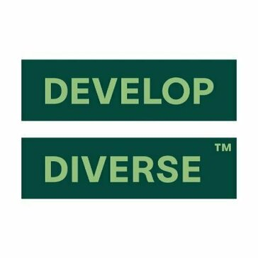









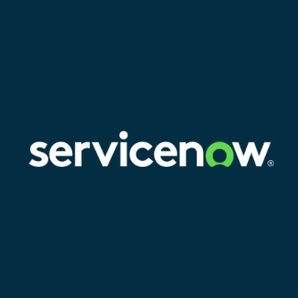



Technology Stack
Finance & Accounting Software
Financial Services & Insurance Software
CashControl
cytric Travel & Expense
Efficient Finance
Kyriba
Claimable
Tercero
Food & Beverage Software
Generative AI Software
ServSafe
Bing Chat
Develop Diverse
ChatGPT
Github Copilot
Geographic Information System Software
Governance, Risk & Compliance Software
Google Maps API
ArcGIS Enterprise
ArcGIS Pro
Google Earth
Workiva
OneTrust
RSA Archer
ServiceNow Governance, Risk and Compliance
Health Care Software
Hospitality Software
Arezzo
Valant Behavioral Health EHR
Restoke
Note: The tools listed above are not exhaustive.

Slide 41


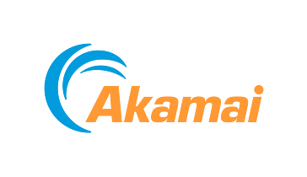


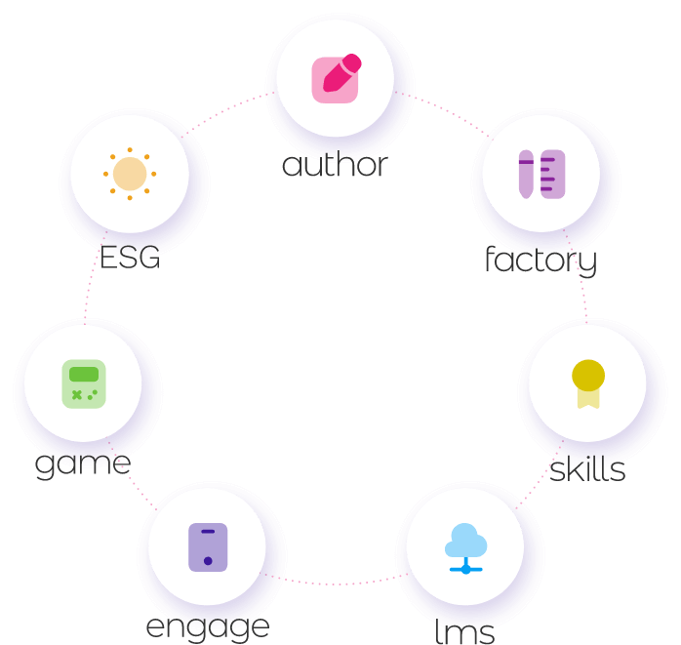













Technology Stack
Hosting Providers
Human Capital Management Software
Amazon Route 53
Register.com
Akamai
Cloudflare
AllWork
B-Talent
Elearning Platform
EngageWith
IT Infrastructure Software
IT Management Software
BeyondTrust Remote Support
Citrix XenApp
Datadog
Nmap
Amazon CloudWatch
Azure Purview
BetterCloud
BigPanda
Laboratory Software
Marine Software
imagej
Orion Performance Monitoring
Marketing Software
Networking Hardware
Adobe Target
Akamai Client Reputation
Amazon SES
Brandwatch
Cisco Meraki MX firewalls
Note: The tools listed above are not exhaustive.

Slide 42


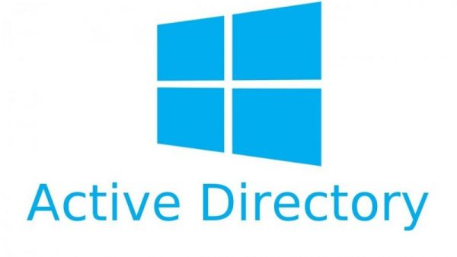













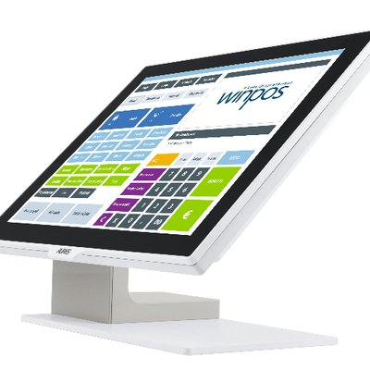










Technology Stack
Nonprofit Software
Office Administration Software
Blackbaud CRM
Funraise
Active Directory
Apigee
aruba
Gmail
Operating Systems Software
Payment Software
Linux
Apple iOS
Windows Server
Windows 10
PayPal
Adyen
Payflex
American Express
Point-of-Sale Software
Procurement Software
FirstData
Retail POS
Winpos
AP Recovery
Basware
SAP Ariba
Ivalua
Productivity & Collaboration Software
Product Lifecycle Management Software
Citrix Workspace
Poppulo
Verizon (ACS)
Microsoft SharePoint
Centro
SolidWorks PDM
Note: The tools listed above are not exhaustive.

Slide 43
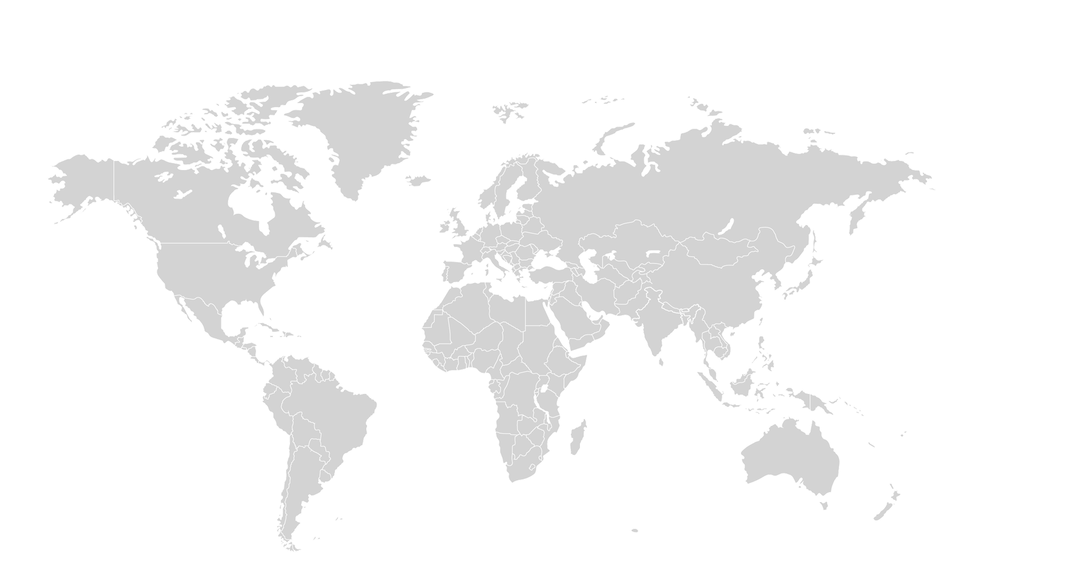
Global Footprint:
Supply Chain
Global Supply Chain Footprint for McDonald's Corporation
16
Total Number of Locations
310
46
Key Locations
Total Workforce
Paris Area, France Greater London, United Kingdom Cagliari Area, Italy Dubai, United Arab Emirates Haute-Garonne Area, France
660
Focused Workloads for Top Locations
Americas
~47.0%
~30.3%
APAC
Paris Area, France • Logistics & Distribution • Fulfilment Management • Warehousing Greater London, United Kingdom • Logistics & Distribution • Warehousing • Inventory Management
EMEA
~22.7%
19
200
11
150
Key Locations
Key Locations
Greater Chicago Area, United States Toronto Area, Canada Greater Los Angeles Area, United States Greater Seattle Area, United States Houston, Texas Area, United States
Greater Sydney Area, Australia Tokyo, Japan National Capital Region, India Selangor, Malaysia Singapore
No. of Locations
Total Workforce
Regional Workforce Proportion
Note: Percentages may not sum to 100%, because of rounding. The above-mentioned focused workloads are not exhaustive.

Slide 44
Global Footprint:
Legal
Global Legal Footprint for McDonald's Corporation
16
Total Number of Locations
74
25
Key Locations
Total Workforce
Greater London, United Kingdom Paris Area, France Madrid Area, Spain Warsaw, Poland Cairo, Egypt
170
Focused Workloads for Top Locations
Americas
~43.5%
~47.6%
APAC
Greater London, United Kingdom • Litigation • Legal Support & Paralegal • Contract Management & Transaction Greater Chicago Area, United States • Legal Support & Paralegal • Litigation • Contract Management & Transaction • Intellectual Property Rights
EMEA
~8.8%
7
81
2
15
Key Locations
Key Locations
Greater Chicago Area, United States Toronto Area, Canada Greater Los Angeles Area, United States Kansas City Metropolitan Area, United States Coffeyville, Kansas Area, United States
Greater Sydney Area, Australia Hanoi, Vietnam
No. of Locations
Total Workforce
Regional Workforce Proportion
Note: Percentages may not sum to 100%, because of rounding. The above-mentioned focused workloads are not exhaustive.

Slide 45
Global Footprint:
IT
Global IT Footprint for McDonald's Corporation
13
Total Number of Locations
4,230
31
Key Locations
Total Workforce
Milan Area, Italy Paris Area, France Greater London, United Kingdom Johannesburg, Gauteng, South Africa Munich Area, Germany
14,410
Focused Workloads for Top Locations
Americas
~29.4%
~49.5%
APAC
Toronto Area, Canada • Business Intelligence & Analytics • Data Engineering • Infrastructure Management System • It Risk Management • Application Development & Maintenance Greater Chicago Area, United States • Business Intelligence & Analytics • It Risk Management • Infrastructure Management System • Data Engineering • Application Development & Maintenance
EMEA
~21.1%
8
7,140
10
3,040
Key Locations
Key Locations
Greater Chicago Area, United States Toronto Area, Canada Greater New York City Area, United States Sao Paulo Area, Brazil Buenos Aires, Argentina
Jakarta, Indonesia Greater Sydney Area, Australia Mumbai Area, India Federal Territory of Kuala Lumpur, Malaysia Singapore
No. of Locations
Total Workforce
Regional Workforce Proportion
Note: Percentages may not sum to 100%, because of rounding. The above-mentioned focused workloads are not exhaustive.

Slide 46
Global Footprint:
Sales & Marketing
Global Sales & Marketing Footprint for McDonald's Corporation
76
Total Number of Locations
16,936
154
Key Locations
Total Workforce
Greater London, United Kingdom Paris Area, France Munich Area, Germany Milan Area, Italy Madrid Area, Spain
34,510
Focused Workloads for Top Locations
Americas
~49.1%
~34.3%
APAC
Greater London, United Kingdom • Marketing Strategy & Brand Management • Communication & Public Relation • Account Management • Digital Marketing • Business Development Greater Chicago Area, United States • Marketing Strategy & Brand Management • Sales Strategy & Planning • Communication & Public Relation • Digital Marketing • Market Research & Intelligence
EMEA
~16.6%
51
11,838
27
5,736
Key Locations
Key Locations
Greater Chicago Area, United States Toronto Area, Canada Washington D.C. Metro Area, United States Greater Los Angeles Area, United States Greater New York City Area, United States
Tokyo, Japan Greater Sydney Area, Australia Shanghai, China Singapore Mumbai Area, India
No. of Locations
Total Workforce
Regional Workforce Proportion
Note: Percentages may not sum to 100%, because of rounding. The above-mentioned focused workloads are not exhaustive.

Slide 47
Global Footprint:
Human Resources
Global Human Resources Footprint for McDonald's Corporation
57
Total Number of Locations
285
130
Key Locations
Total Workforce
Greater London, United Kingdom Munich Area, Germany Paris Area, France Budapest, Hungary Madrid Area, Spain
550
Focused Workloads for Top Locations
Americas
~51.8%
~34.0%
APAC
Greater London, United Kingdom • Learning & Development • Talent Acquisition • Employee Relation, Engagement & Retention • Hr Strategy & Governance • Payroll Greater Chicago Area, United States • Workforce Administration & Management • Learning & Development • Talent Acquisition • Payroll • Compensation & Benefits
EMEA
~14.2%
55
187
18
78
Key Locations
Key Locations
Greater Chicago Area, United States Toronto Area, Canada Greater New York City Area, United States Washington D.C. Metro Area, United States Greater Atlanta Area, United States
Greater Sydney Area, Australia Tokyo, Japan Greater Perth Area, Australia Greater Melbourne Area, Australia Shanghai, China
No. of Locations
Total Workforce
Regional Workforce Proportion
Note: Percentages may not sum to 100%, because of rounding. The above-mentioned focused workloads are not exhaustive.

Slide 48
Global Footprint:
Procurement
Global Procurement Footprint for McDonald's Corporation
25
Total Number of Locations
155
44
Key Locations
Total Workforce
Greater London, United Kingdom Paris Area, France Moscow, Russia Madrid Area, Spain Warsaw, Poland
340
Focused Workloads for Top Locations
Americas
~45.6%
~30.9%
APAC
Greater London, United Kingdom • Strategic Sourcing & Purchasing • Vendor Management Greater Chicago Area, United States • Strategic Sourcing & Purchasing • Vendor Management
EMEA
~23.5%
8
105
11
80
Key Locations
Key Locations
Greater Chicago Area, United States Toronto Area, Canada Sao Paulo Area, Brazil Buenos Aires, Argentina Richmond, Virginia Area, United States
Tokyo, Japan Greater Sydney Area, Australia Singapore Shanghai, China Bangkok City, Thailand
No. of Locations
Total Workforce
Regional Workforce Proportion
Note: Percentages may not sum to 100%, because of rounding. The above-mentioned focused workloads are not exhaustive.

Slide 49
Global Footprint:
Customer Support & Service
Global Customer Support & Service Footprint for McDonald's Corporation
102
Total Number of Locations
16,619
292
Key Locations
Total Workforce
Greater London, United Kingdom Greater Manchester, United Kingdom West Midlands, United Kingdom Kent, United Kingdom Tyne and Wear, United Kingdom
39,390
Focused Workloads for Top Locations
Americas
~42.2%
~43.9%
APAC
Sao Paulo Area, Brazil • Customer Service & Support • Product Installation, Maintenance & Technical Support • Customer Success Greater London, United Kingdom • Customer Service & Support • Customer Success
EMEA
~13.9%
159
17,297
31
5,474
Key Locations
Key Locations
Sao Paulo Area, Brazil Toronto Area, Canada Greater Chicago Area, United States Buenos Aires, Argentina Greater Los Angeles Area, United States
Greater Sydney Area, Australia Greater Melbourne Area, Australia Greater Brisbane Area, Australia Tokyo, Japan Rest of Queensland, Australia
No. of Locations
Total Workforce
Regional Workforce Proportion
Note: Percentages may not sum to 100%, because of rounding. The above-mentioned focused workloads are not exhaustive.

Slide 50
Global Footprint:
Finance & Accounting
Global Finance & Accounting Footprint for McDonald's Corporation
42
Total Number of Locations
271
99
Key Locations
Total Workforce
Paris Area, France Greater London, United Kingdom Munich Area, Germany Cairo, Egypt Madrid Area, Spain
548
Focused Workloads for Top Locations
Americas
~49.5%
~33.8%
APAC
Paris Area, France • General Accounting • Financial Planning & Analysis • Treasury & Risk Greater Chicago Area, United States • Financial Planning & Analysis • General Accounting • Tax • Internal Audit & Reporting • Treasury & Risk
EMEA
~16.8%
33
185
24
92
Key Locations
Key Locations
Greater Chicago Area, United States Columbus, Ohio Area, United States Toronto Area, Canada Greater New York City Area, United States Sao Paulo Area, Brazil
Greater Sydney Area, Australia National Capital Region, Philippines Hong Kong Bangkok City, Thailand Greater Brisbane Area, Australia
No. of Locations
Total Workforce
Regional Workforce Proportion
Note: Percentages may not sum to 100%, because of rounding. The above-mentioned focused workloads are not exhaustive.

Slide 51
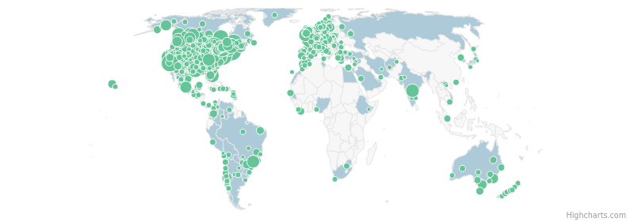
Hiring Analysis – Overall
51759
Job Postings (in last 12 Months)
1684
Locations with Job Postings (in last 12 Months)
Top Locations | # of Job Postings
Greater Chicago Area, United States | 2383
Greater London, United Kingdom | 1299
Greater Boston Area, United States | 1244
Greater New York City Area, United States | 1098
Greater Atlanta Area, United States | 1067
Washington D.C. Metro Area, United States | 977
Rest of Quebec, Canada | 861
Greater Los Angeles Area, United States | 734
Dallas-Fort Worth Area, United States | 716
Greater Detroit Area, United States | 703
Job Postings Timeline
HIGH
MEDIUM
LOW
Recent Executive Movements
Top Business Functions
Top Workloads
Pat Myers Joined as SVP, US Chief People Officer, McDonald's Corporation May. 2025
Cannon Cottle Quit as Manager of Endpoint Security (EDR), McDonald's Corporation May. 2025
Adam Cooper Promoted as Chief Technology Officer - McDonald's Canada, McDonald's Corporation May. 2025
Customer Support & Service Hospitality Operations Administrative Operations Human Resources IT
Food & Beverages Customer Service & Support Retail Store Operations Asset Maintenance & Engineering Workforce Administration & Management
Vice President, Human Resources, Global Operations , Medtronic Public Limited Company
Senior Director of Security, Entrata, Inc.
Digital Experience & Product Manager, McDonald's Corporation
Get more insights
Note: The insights as mentioned above are based on job postings data for the last 12 months and are not exhaustive

Slide 52
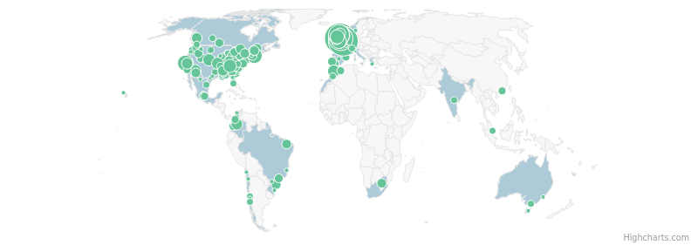
Hiring Analysis – Customer Support & Service
3749
Job Postings (in last 12 Months)
288
Locations with Job Postings (in last 12 Months)
Top Locations | # of Job Postings
Merseyside, United Kingdom | 152
Greater London, United Kingdom | 139
Kent, United Kingdom | 109
Lancashire, United Kingdom | 108
Lincolnshire, United Kingdom | 91
Greater Manchester, United Kingdom | 88
West Yorkshire, United Kingdom | 87
West Midlands, United Kingdom | 86
South Yorkshire, United Kingdom | 83
Nottinghamshire, United Kingdom | 81
Job Postings Timeline
HIGH
MEDIUM
LOW
Recent Executive Movements
Top Workloads
Job Titles in Demand
Core Skills in Demand
Jackie Bruzek Promoted as Vice President, Customer Engagement, McDonald's Corporation Apr. 2025
Customer Service & Support Product Installation, Maintenance & Technical Support Food & Beverages Corporate Strategy & Management Consulting Customer Success
Customer Care Customer Care Assistant Field Operations Consultant Maintenance Technician Facilities Manager
Safety Awareness Root Cause Analysis (RCA) Customer Experience Management Plumbing Preventive Maintenance
Senior Director, Customer Experience, McDonald's Corporation
Get more insights
Note: The insights as mentioned above are based on job postings data for the last 12 months and are not exhaustive

Slide 53
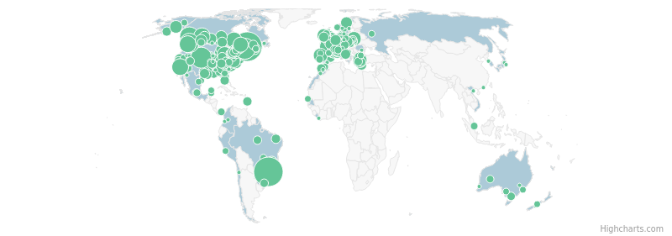
Hiring Analysis – Hospitality Operations
3715
Job Postings (in last 12 Months)
663
Locations with Job Postings (in last 12 Months)
Top Locations | # of Job Postings
Sao Paulo Area, Brazil | 206
Rest of Quebec, Canada | 200
Greater Denver Area, United States | 85
Granby Area, Canada | 84
Vancouver Area, Canada | 70
Loire-Atlantique Area, France | 69
Rest of British Columbia, Canada | 68
Vendee Area, France | 66
Bern Area, Switzerland | 60
Greater Pittsburgh Area, United States | 51
Job Postings Timeline
HIGH
MEDIUM
LOW
Recent Executive Movements
Top Workloads
Job Titles in Demand
Core Skills in Demand
Adam Cooper Promoted as Chief Technology Officer - McDonald's Canada, McDonald's Corporation May. 2025
Cesar Pina Promoted as SVP, Chief Supply Chain Officer for McDonald's North America, McDonald's Corporation Oct. 2024
Food & Beverages Lodging Corporate Strategy & Management Consulting Wellness Workforce Administration & Management
Restaurant Manager Restaurant Attendant Cook Catering Employee Restaurant Employee
Quality Control Inventory Management Safety Awareness Food Production Food Preparation
Digital Experience & Product Manager, McDonald's Corporation
Vice President Global Supply Chain, Strategic Sourcing for Food, McDonald's Corporation
Get more insights
Note: The insights as mentioned above are based on job postings data for the last 12 months and are not exhaustive

Slide 54
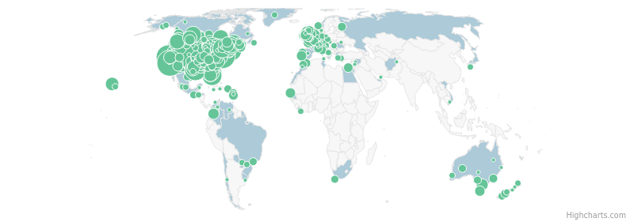
Hiring Analysis – Administrative Operations
2233
Job Postings (in last 12 Months)
720
Locations with Job Postings (in last 12 Months)
Top Locations | # of Job Postings
Greater Denver Area, United States | 105
Greater Chicago Area, United States | 96
Washington D.C. Metro Area, United States | 89
Greater Los Angeles Area, United States | 87
San Francisco Bay Area, United States | 75
Dallas-Fort Worth Area, United States | 73
Greater New York City Area, United States | 69
Greater Atlanta Area, United States | 68
Greater Detroit Area, United States | 64
Houston, Texas Area, United States | 52
Job Postings Timeline
HIGH
MEDIUM
LOW
Recent Executive Movements
Top Workloads
Job Titles in Demand
Core Skills in Demand
Colleen Wade Spelder Promoted as ESG Transformation Director, McDonald's Corporation Sep. 2024
Asset Maintenance & Engineering Admin & Support Environment, Health & Safety Food & Beverages Security & Surveillance/Asset Protection
Maintenance Maintenance Person Janitor Administrative Assistant Shift Managers
Electrical Maintenance Microsoft Office Inventory Management Maintenance Repair & Operations Equipment Maintenance
Impact Reporting and ESG Governance Director, McDonald's Corporation
Get more insights
Note: The insights as mentioned above are based on job postings data for the last 12 months and are not exhaustive

Slide 55
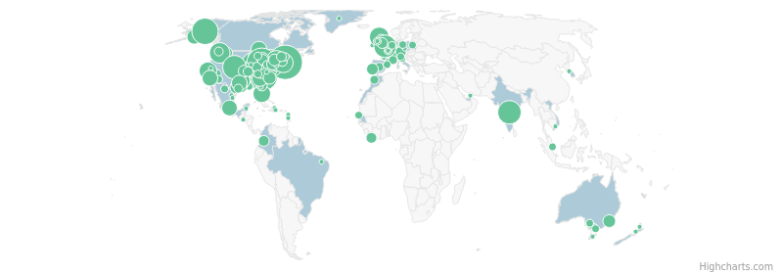
Hiring Analysis – Human Resources
1979
Job Postings (in last 12 Months)
236
Locations with Job Postings (in last 12 Months)
Top Locations | # of Job Postings
Greater Boston Area, United States | 149
Greater Chicago Area, United States | 106
Greater Cleveland Area, United States | 98
Greenville-Spartanburg-Anderson, South Carolina Area, United States | 85
Anchorage, Alaska Area, United States | 75
Greater Pittsburgh Area, United States | 62
Greater Denver Area, United States | 58
Hyderabad Area, India | 57
Des Moines, Iowa Area, United States | 51
Greater London, United Kingdom | 49
Job Postings Timeline
HIGH
MEDIUM
LOW
Recent Executive Movements
Top Workloads
Job Titles in Demand
Core Skills in Demand
Laura Coogan, SPHR Promoted as Senior Director, Global People Modernization Organization Activation Lead, McDonald's Corporation Dec. 2024
Workforce Administration & Management Talent Acquisition Learning & Development Compensation & Benefits Business Intelligence & Analytics
Shift Manager Crew Team Member Team Member General Manager Crew Member
Inventory Management Food Production Security Monitoring Microsoft Office Recruitment
Director, US Segment Talent Lead, McDonald's Corporation
Get more insights
Note: The insights as mentioned above are based on job postings data for the last 12 months and are not exhaustive

Slide 56
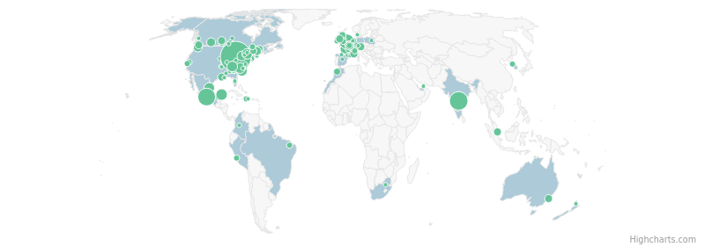
Hiring Analysis – IT
1429
Job Postings (in last 12 Months)
144
Locations with Job Postings (in last 12 Months)
Top Locations | # of Job Postings
Greater Chicago Area, United States | 454
Hyderabad Area, India | 116
Mexico City Area, Mexico | 109
Greater London, United Kingdom | 70
Yucatan Area, Mexico | 28
Tamaulipas Area, Mexico | 24
Greater Nashville, Tennessee Area, United States | 24
Charlotte, North Carolina Area, United States | 22
Greater Myrtle Beach Area, United States | 21
Toronto Area, Canada | 20
Job Postings Timeline
HIGH
MEDIUM
LOW
Recent Executive Movements
Top Workloads
Job Titles in Demand
Core Skills in Demand
John Duffield Promoted as Director, Revenue Growth Management - Mass & Differentiated Offers And Rewards, McDonald's Corporation Mar. 2025
Benjamin Istvan Promoted as Senior Director, Enterprise Data Analytics & Ai - Planning & Alignment, McDonald's Corporation Feb. 2025
Business Intelligence & Analytics Data Engineering UI/UX Design Project/Programs Management Customer Service & Support
Customer Experience Leader Manager Of The Customer Experience General Manager Shift Manager Software Engineer Ii - Android
Customer Experience Management Python (Programming Language) Software Development Cybersecurity Data Structures
Director, Us Finance & Business Insights - Affordability, Digital & Delivery Strategy, McDonald's Corporation
Senior Director, Generative Ai Business Lead, McDonald's Corporation
Get more insights
Note: The insights as mentioned above are based on job postings data for the last 12 months and are not exhaustive

Slide 57
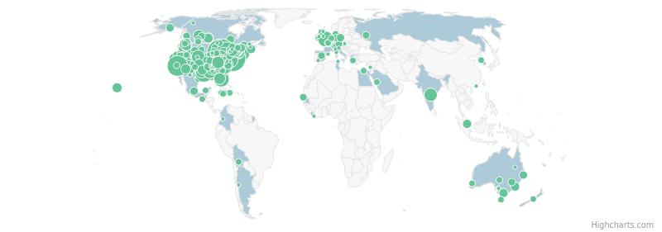
Hiring Analysis – Management & Strategy
1359
Job Postings (in last 12 Months)
424
Locations with Job Postings (in last 12 Months)
Top Locations | # of Job Postings
Greater Chicago Area, United States | 192
Washington D.C. Metro Area, United States | 157
Greater New York City Area, United States | 107
Greater Detroit Area, United States | 87
Greater Atlanta Area, United States | 87
Dallas-Fort Worth Area, United States | 83
Greater Los Angeles Area, United States | 82
Virginia Beach-Norfolk, Virginia Area, United States | 70
Phoenix, Arizona Area, United States | 61
Greater Cleveland Area, United States | 61
Job Postings Timeline
HIGH
MEDIUM
LOW
Recent Executive Movements
Top Workloads
Job Titles in Demand
Core Skills in Demand
Becky C. Promoted as Global Product Director - Customer Value, McDonald's Corporation Sep. 2024
Alan Lippert, PMP Joined as Director, Change Management - US, McDonald's Corporation Sep. 2024
Corporate Strategy & Management Consulting Project/Programs Management Leadership & Governance Product Management Governance, Risk & Compliance
General Manager Department Manager Shift Manager Construction Project Manager Operations Consultant
Food Production Performance Management Inventory Management Project Management Recruitment
Global Product Director - Loyalty & Gaming, McDonald's Corporation
Deputy Chief Transformation Officer, Rite Aid Corporation
Get more insights
Note: The insights as mentioned above are based on job postings data for the last 12 months and are not exhaustive

Slide 58
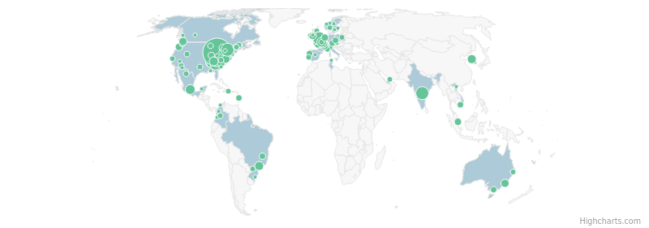
Hiring Analysis – Sales & Marketing
1197
Job Postings (in last 12 Months)
123
Locations with Job Postings (in last 12 Months)
Top Locations | # of Job Postings
Greater Chicago Area, United States | 490
Greater London, United Kingdom | 66
Hyderabad Area, India | 62
Toronto Area, Canada | 57
Yvelines Area, France | 26
Greater Atlanta Area, United States | 26
Mexico City Area, Mexico | 23
Sao Paulo Area, Brazil | 20
Seoul, South Korea | 17
Greater Nashville, Tennessee Area, United States | 16
Job Postings Timeline
HIGH
MEDIUM
LOW
Recent Executive Movements
Top Workloads
Job Titles in Demand
Core Skills in Demand
William Turk Promoted as Director, Integration, Training, and Deployment, McDonald's Corporation Dec. 2024
Jennifer DelVecchio Promoted as Senior Director, Head of US Marketing & Menu Strategy, McDonald's Corporation Dec. 2024
Sales Strategy & Planning Sales Enablement & Support Marketing Strategy & Brand Management Product Management Business Intelligence & Analytics
Assistant Store Manager Store Manager General Manager (Store Manager) Point Of Sale Manager Technical Product Analyst
Project Management Continuous Improvement Management Atlassian Jira Marketing Stakeholder Management
Director, Operations Innovation Enablement, McDonald's Corporation
Senior Director, Head of US Marketing Strategy, McDonald's Corporation
Get more insights
Note: The insights as mentioned above are based on job postings data for the last 12 months and are not exhaustive

Slide 59
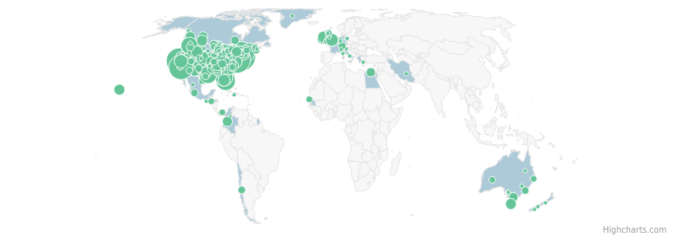
Hiring Analysis – Travel & Transport Operations
971
Job Postings (in last 12 Months)
448
Locations with Job Postings (in last 12 Months)
Top Locations | # of Job Postings
Greater New York City Area, United States | 125
Washington D.C. Metro Area, United States | 106
San Francisco Bay Area, United States | 91
Greater Los Angeles Area, United States | 77
Dallas-Fort Worth Area, United States | 67
Greater Chicago Area, United States | 48
Miami-Fort Lauderdale Area, United States | 43
Columbus, Ohio Area, United States | 41
Orlando, Florida Area, United States | 37
Tampa-St. Petersburg, Florida Area, United States | 36
Job Postings Timeline
HIGH
MEDIUM
LOW
Top Workloads
Job Titles in Demand
Core Skills in Demand
Airline & Airport Operations Rail & Road Operations Logistics & Distribution
Crew Member Crew Team Member Crew Shift Manager Shift Coordinator
Safety Awareness Food Preparation Stocking Inventory Management Centric Platform
Get more insights
Note: The insights as mentioned above are based on job postings data for the last 12 months and are not exhaustive

Slide 60
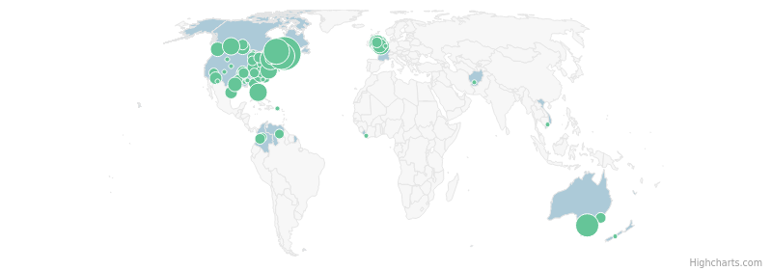
Hiring Analysis – Retail Operations
464
Job Postings (in last 12 Months)
99
Locations with Job Postings (in last 12 Months)
Top Locations | # of Job Postings
Rest of Quebec, Canada | 56
Granby Area, Canada | 33
Val-d'Or Area, Canada | 28
Montreal Area, Canada | 27
Greater Melbourne Area, Australia | 21
Toronto Area, Canada | 18
Miami-Fort Lauderdale Area, United States | 12
Richmond, Virginia Area, United States | 11
Calgary Area, Canada | 11
Kent, United Kingdom | 10
Job Postings Timeline
HIGH
MEDIUM
LOW
Top Workloads
Job Titles in Demand
Core Skills in Demand
Retail Store Operations Asset Maintenance & Engineering E-Commerce Operations
Cashier Crew Member Night Cashier Shift Leader Cashier - Crew Team Member
Safety Awareness Food Preparation Customer Service Operations Quality Control Stock Rotation
Get more insights
Note: The insights as mentioned above are based on job postings data for the last 12 months and are not exhaustive

Slide 61
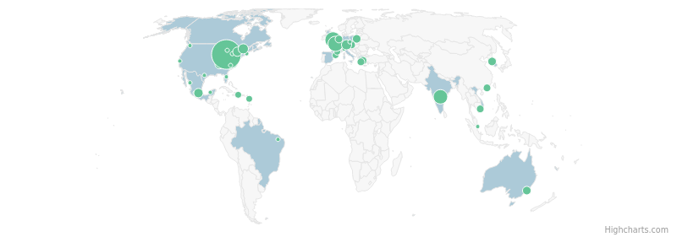
Hiring Analysis – Finance & Accounting
377
Job Postings (in last 12 Months)
47
Locations with Job Postings (in last 12 Months)
Top Locations | # of Job Postings
Greater Chicago Area, United States | 163
Greater London, United Kingdom | 33
Yvelines Area, France | 29
Hyderabad Area, India | 23
Munich Area, Germany | 9
Ottawa-Gatineau Area, Canada | 8
Mexico City Area, Mexico | 7
Blytheville, Arkansas Area, United States | 7
Toronto Area, Canada | 6
West Midlands, United Kingdom | 5
Job Postings Timeline
HIGH
MEDIUM
LOW
Top Workloads
Job Titles in Demand
Core Skills in Demand
Financial Planning & Analysis General Accounting Corporate Strategy & Management Consulting Internal Audit & Reporting Business Intelligence & Analytics
Accountant Bookkeeper/Payroll Administrator Functional Solutions Lead - Oracle Enterprise Planning And Budgeting Shift Manager Fp&A Manager
Auditing Internal Controls Financial Reporting Financial Planning Microsoft Excel
Get more insights
Note: The insights as mentioned above are based on job postings data for the last 12 months and are not exhaustive

Slide 62
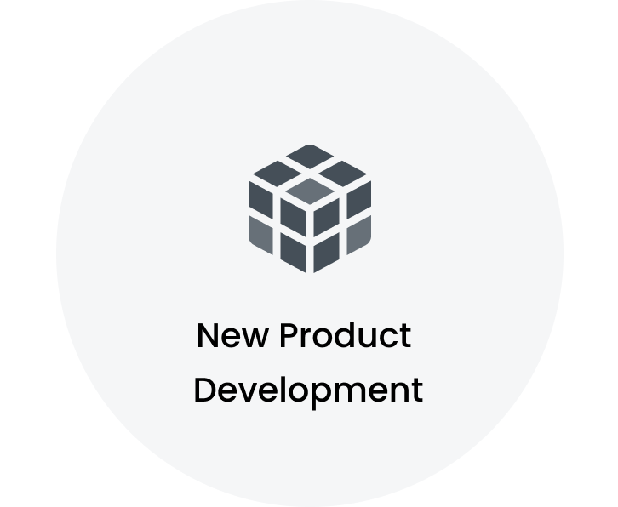
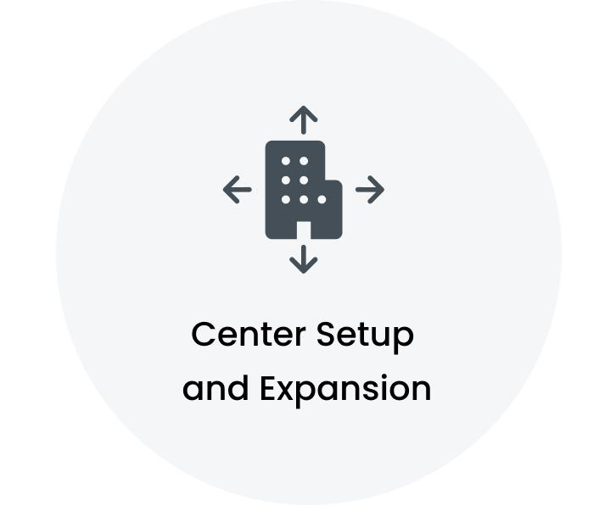
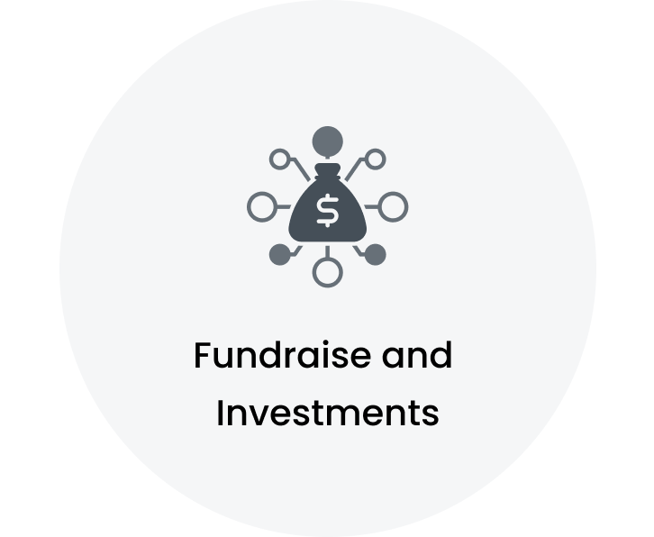
Key Signals
McDonald's Unveils Its Full Lineup of New Pokmon Happy Meal Toys for August McDonald's rolls out adult Happy Meal with 1970s throwback in bid to revive flagging sales McDonald's Releases New McDonaldland Meal and Shake McDonald's Announces Menu Change for Hundreds of Stores Next Month
McDonalds wants to open global AI center in Poland Bigger moves: McDonalds to invest $100 million in Hyderabad over next two years; to hire 2,000 techies AI hiring woes are pushing some companies like McDonald's and Bupa to India's "tech hubs" Jobs in and around Oakham this week: McDonald's, Domino's, Wisteria Hotel and more
Local McDonalds donates $25,000 to Huntsville Hospital Foundation McDonald's plans to 'double down' on AI investment by 2027, executive says Alliston hospital receives $200K through McDonald's fundraiser Area McDonalds restaurants raise $6,500 for flood victims through digital fundraiser
Note: The signals mentioned above are not exhaustive.

Slide 63
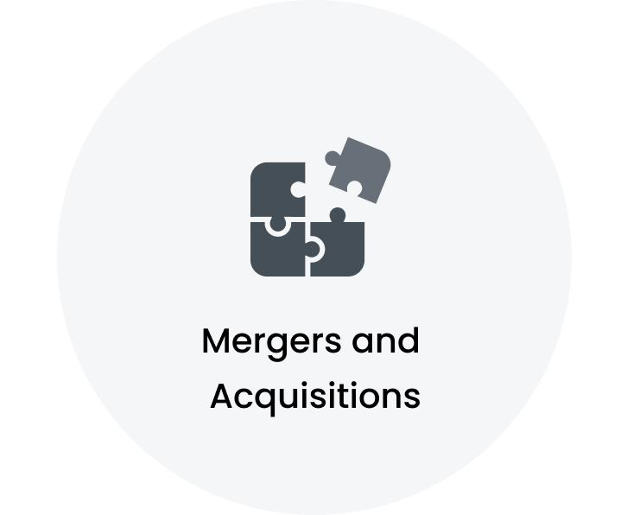
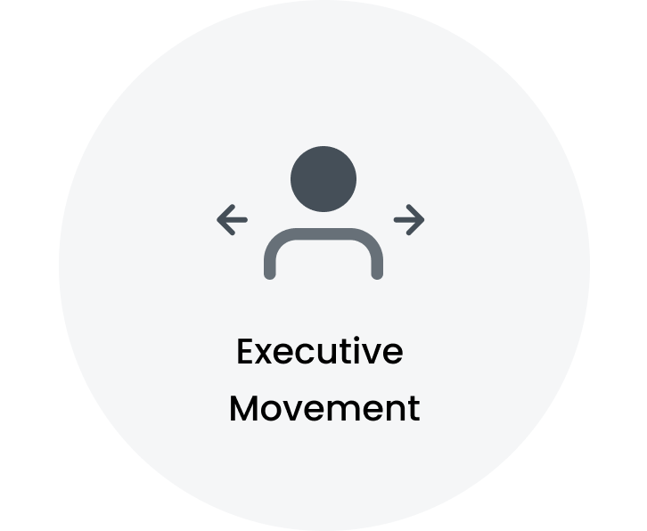
Key Signals
McDonald's to Sell Premium Hong Kong Retail Properties, Analysts See 11.6% Upside McDonald's to sell 8 Hong Kong retail spaces valued at $153M McDonald Companies has option to purchase former Georgia Pacific mill site in Green Bay Trending this week: McDonald's is hopping onto the latest drink trend
McDonalds Canada announces new CEO, taking effect in September McDonalds gets Aarti Kapoor as director-global HR operations McDonalds Appoints Valerie Ashbaugh as US CIO in Strategic Leadership Shift McDonalds hires Paloma Azulay as VP, global brand marketing
Note: The signals mentioned above are not exhaustive.

Slide 64
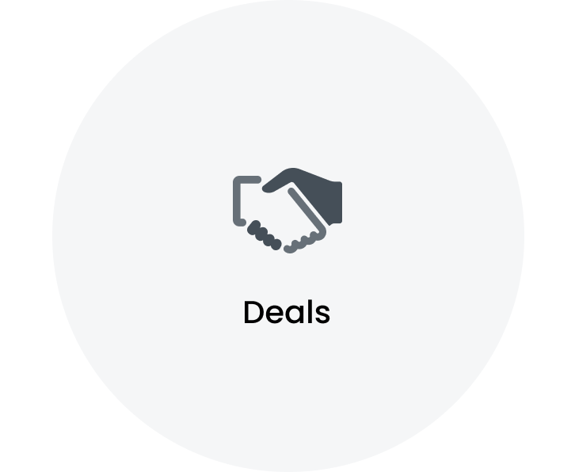
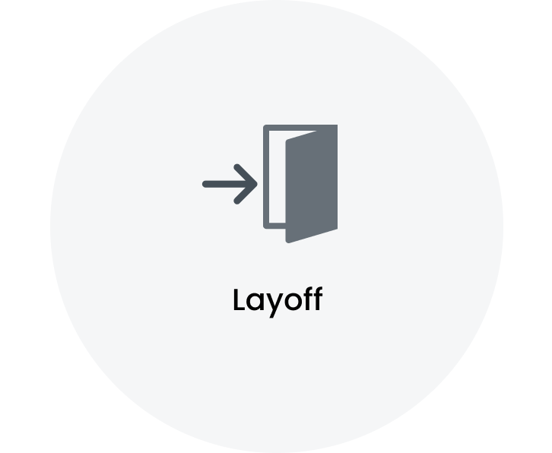
Key Signals
McDonalds Spain trusts us to lead its communications and brand reputation Krispy Kreme and McDonalds USA Announce Joint Decision to End Partnership AsiaPay Partners with McDonald's to launch Seamless Online Payment Solution AsiaPay Partners with McDonald's to launch Seamless Online Payment Solution, Enhancing Customer Transaction Experience in Taiwan
McDonald's To Close All Spinoff Branches It Launched Across US After Just Two Years, McDonalds Is Closing All CosMcs McDonalds falls short in the sales race and shuts down one of its boldest ventures McDonald's to close standalone beverage concept
Note: The signals mentioned above are not exhaustive.

Slide 65


Outsourcing Overview: Software Testing is the highly outsourced segment
Active Outsourcing Partners
~
124
Total Workforce analyzed
~
6784
Highlights
Workflows split by Micro verticals
Key Service Providers are Capgemini | Evalueserve | Cognizant Top Outsourced Workloads are Software Testing | Application Development & Maintenance | DevOps Top Service Partner Locations are Hyderabad Area, India | Pune Area, India | Bengaluru Area, India
Changes in last 12 months
3 New Service Providers engaged including Miroma Group | Coforge | Aprio, LLP McDonald's Corporation started taking services from 5 new locations including Cluj County, Romania | Raleigh-Durham, North Carolina Area, United States | Fayetteville, Arkansas Area, United States McDonald's Corporation started outsourcing 5 new workloads including Sales Enablement & Support | Event Management | Legal Governance & Compliance

Slide 66
Vendor Analysis: A Comprehensive List of Top 15 Companies
Capgemini, Evalueserve, Cognizant are the key service providers for McDonald's Corporation
Top 15 service providers cover 74% of the total outsourcing workflows
Key Provider Locations:
Hyderabad Area, India Pune Area, India Bengaluru Area, India National Capital Region, India Paris Area, France

Slide 67





Top 5 Service Providers:
Capgemini is the key strategic partner for McDonald's Corporation
Key Provider | Key Provider MSA | Workflows split by Micro Vertical
Pune Area, India Bengaluru Area, India Hyderabad Area, India
Valparaiso Region, Chile National Capital Region, India Cluj County, Romania
Hyderabad Area, India Chennai Area, India Kolkata Area, India
Hyderabad Area, India Bengaluru Area, India Pune Area, India
Singapore Federal Territory of Kuala Lumpur, Malaysia Beirut Governorate, Lebanon

Slide 68


Functional Workload Deep Dive (1/20): Software Testing
Total Outsourcing Partners
Total Workflows Analyzed
Service Providers | Key Workflow
 | • Software requirement specification document analysis • Functional test case writing • Test case review for team and USA submissions
 | • Test Manager role • Management of information for product creation and sales through central database • Implementation of Product Item Master for supply chain strategy
 | • QA Lead • QA Testing Engineer
 | • Test case identification and prioritization for automation • Automation framework development with custom utility methods • Element locator writing and Object Repository updates
 | • Customer-centric platform • Convenient mobile ordering
~ 18
~ 119
Share by Service Providers
Key Provider Locations
Pune Area, India
Hyderabad Area, India
Bengaluru Area, India
National Capital Region, India
Kolkata Area, India
Note: Service Provider share is based on the number of projects.

Slide 69

Functional Workload Deep Dive (2/20): Application Development & Maintenance
Total Outsourcing Partners
Total Workflows Analyzed
Service Providers | Key Workflow
 | • Jenkins, Git, and Java for Springboot and Microservices development • AWS for deployment and Confluence for documentation • Agile methodology with JIRA for project management
 | • Requirement gathering and analysis of JIRA tickets • Coding, designing, and unit/integration testing • Integration solutions design, development, and deployment using Oracle Integration Cloud
 | • Accurate and timely translation of Spanish language work into English language • Understanding of business documents and marketing material for context preservation • Consultation with subject...
 | • Key contributions to projects for prestigious clients • Development excellence through high-quality code production • Full-stack mastery in C#, WPF, .NET Framework, ASP.NET, HTML, CSS, JavaScr...
 | • BI and OTBI Reports for Finance and SCM modules • Complex Templates using BI Publisher Desktop • Functional understanding of Receivables, Payables, and General Accounting modules
~ 28
~ 116
Share by Service Providers
Key Provider Locations
Hyderabad Area, India
Bengaluru Area, India
Pune Area, India
National Capital Region, India
Mumbai Area, India
Note: Service Provider share is based on the number of projects.

Slide 70


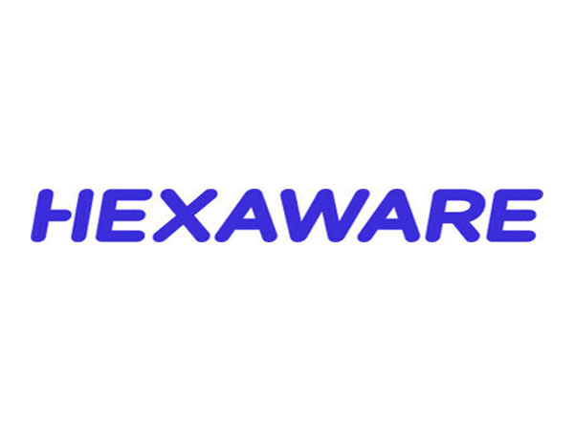
Functional Workload Deep Dive (3/20): DevOps
Total Outsourcing Partners
Total Workflows Analyzed
Service Providers | Key Workflow
 | • Automation processes leveraging Terraform for streamlined operations and enhanced productivity • Configuration of cloud resources including CloudWatch metric alarms and IAM roles for API Gate...
 | • Cloud-based infrastructure architecture, design, implementation, and support • Proficiency in AWS services including VPC, EC2, ECS, S3, ELB, Auto Scaling Groups, EBS, RDS, IAM, Route 53, Clou...
 | • Architecting cloud-based infrastructure and solutions • Designing and implementing AWS services including VPC, EC2, and S3 • Creating VPCs and subnets across availability zones
 | • Architecting, designing, implementing, and supporting cloud-based infrastructure and solutions • Creating multiple VPCs and public, private subnets distributed across various availability zon...
 | • Installation and configuration of Oracle RAC two-node cluster • Management of production, development, and QA database environments including design, troubleshooting, performance, and backup/...
~ 17
~ 50
Share by Service Providers
Key Provider Locations
Hyderabad Area, India
Bengaluru Area, India
Mumbai Area, India
Pune Area, India
Cluj County, Romania
Note: Service Provider share is based on the number of projects.

Slide 71

Functional Workload Deep Dive (4/20): Data Engineering
Total Outsourcing Partners
Total Workflows Analyzed
Service Providers | Key Workflow
 | • Design and implement systems for data movement and integration • Communicate with senior stakeholders on projects demonstrating innovation • Collaborate with global clients and project teams a...
 | • Conceptual logical and physical data models that meet organizational needs • Collaboration with business stakeholders data analysts IT teams and DBA teams for data solution requirements
 | • Data cleansing and transformation for accuracy and consistency • Collaboration with clients for understanding data needs and report delivery • Design and implementation of data architecture, i...
 | • Finance Transformation Journey • Data Migration for Real Estate data from legacy systems into IWMS Platform • Handling multiple markets
 | • Launch of end-to-end voice-ordering technology at drive-thru • Implementation of solution in over 100 stores • Achievement of 75% automation goal
~ 15
~ 45
Share by Service Providers
Key Provider Locations
Bengaluru Area, India
Pune Area, India
Hyderabad Area, India
National Capital Region, India
Valparaiso Region, Chile
Note: Service Provider share is based on the number of projects.

Slide 72

Functional Workload Deep Dive (5/20): Project/Programs Management
Total Outsourcing Partners
Total Workflows Analyzed
Service Providers | Key Workflow
 | • - Strategic analysis, estimation, and design phases with robust quality control measures exceeding project lifecycle standards • - Cross-departmental navigation ensuring seamless project fl...
 | • Roadmap planning and delivery for restaurant operations • Engineering team leadership with over 15 members • Implementation of feature upgrades and functionality improvements
 | • TRIRIGA application migration activities • TRIRIGA installations and upgrades
 | • Global Food Auditors • Lead Auditor responsibilities
 | • Scrum process facilitation • Agile project oversight and guidance • Requirement gathering and documentation
~ 13
~ 35
Share by Service Providers
Key Provider Locations
Pune Area, India
National Capital Region, India
Hyderabad Area, India
Greater Chicago Area, United States
Bengaluru Area, India
Note: Service Provider share is based on the number of projects.

Slide 73



Functional Workload Deep Dive (6/20): Product Installation, Maintenance & Technical Support
Total Outsourcing Partners
Total Workflows Analyzed
Service Providers | Key Workflow
 | • IT-related support desk • First line of support • Assistance with technical issues
 | • Soporte tA(c)cnico para sistemas de punto de venta • Asistencia tA(c)cnica para sistemas operativos Windows • Soporte tA(c)cnico para sistemas de telefonAa IP
 | • IT support for customers including major retailers • Diagnosis and resolution of point-of-sale terminal issues • Preventative maintenance to anticipate potential problems
 | • Technical support for restaurants nationwide • Assistance with operational issues and troubleshooting • Coordination with restaurant staff for problem resolution
 | • Consultation work with sales representatives • Technical and business communication • Introduction of Microsoft 365 products to customers
~ 18
~ 28
Share by Service Providers
Key Provider Locations
Sao Paulo Area, Brazil
Lima-Callao Metropolitan Area, Peru
National Capital Region, India
Hyderabad Area, India
Pune Area, India
Note: Service Provider share is based on the number of projects.

Slide 74

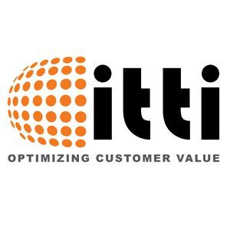
Functional Workload Deep Dive (7/20): Business Intelligence & Analytics
Total Outsourcing Partners
Total Workflows Analyzed
Service Providers | Key Workflow
 | • Development and maintenance of index production platforms • Programming and testing of index-related applications • Management of day-to-day maintenance and delivery issues
 | • - Business Analyst role for McDonalds project - Requirement gathering from Product Manager - Creating Epics & User stories in Jira - Timely delivery of NFRS, Story Tickets, and IDEA Tickets ...
 | • Stakeholder collaboration for business modernization • Membership in Innovation and Strategy council • Analysis of existing business processes and data systems for improvement opportunities
 | • DAGs execution using Apache Airflow for workflow orchestration • Data integration from AWS S3 to AWS Redshift for efficient data management • Data schema development and data visualization thr...
 | • Configuration and deployment of Tableau servers • Monitoring and resolving server issues, maintaining licenses, and ensuring server security • User management and role assignment on Tableau Se...
~ 8
~ 25
Share by Service Providers
Key Provider Locations
Hyderabad Area, India
National Capital Region, India
Bengaluru Area, India
Capital District, Colombia
Cluj County, Romania
Note: Service Provider share is based on the number of projects.

Slide 75


Functional Workload Deep Dive (8/20): Customer Service & Support
Total Outsourcing Partners
Total Workflows Analyzed
Service Providers | Key Workflow
 | • Proven track record in identifying and resolving complex IT and business problems • Expertise in end-to-end problem resolution processes for timely and effective solutions
 | • IT support role • troubleshooting technical issues • providing assistance to end-users
 | • Production issue handling • ServiceNow ticket resolution • Object level and data level security role management
 | • Ticket resolution via ticket manager and telephone technical support for LATAM premises • Documentation of tasks performed and task derivation at software and hardware levels
 | • Customer Engineer • Solid experience in electromechanical and computer technology • Expertise in solving technical challenges
~ 8
~ 22
Share by Service Providers
Key Provider Locations
Pune Area, India
National Capital Region, India
Sao Paulo Area, Brazil
Buenos Aires, Argentina
Greater Chicago Area, United States
Note: Service Provider share is based on the number of projects.

Slide 76


Functional Workload Deep Dive (9/20): Product Management
Total Outsourcing Partners
Total Workflows Analyzed
Service Providers | Key Workflow
 | • Roadmap development and product feature management from concept to launch • Product requirement translation into features, user stories, and acceptance criteria • Functional design crafting ba...
 | • Team leadership • Coordination of team activities • Management of operational tasks
 | • Senior FE engineer on hybrid AEM architect for new homepage • Evaluation of design concept feasibility from technical perspective • Recommendations for responsive component design
 | • Roadmap planning and delivery for restaurant operations • Engineering team leadership with over 15 members • Implementation of feature upgrades and functionality improvements
 | • Customer journey definition and channel role establishment • Experience principle establishment • Global digital design system creation
~ 9
~ 22
Share by Service Providers
Key Provider Locations
National Capital Region, India
Valparaiso Region, Chile
Greater Atlanta Area, United States
Greater Chicago Area, United States
Paris Area, France
Note: Service Provider share is based on the number of projects.

Slide 77

Functional Workload Deep Dive (10/20): Marketing Strategy & Brand Management
Total Outsourcing Partners
Total Workflows Analyzed
Service Providers | Key Workflow
 | • KSA market account management • Strategic planning and execution for market growth • Relationship building with key stakeholders
TLC Marketing | • Management of promotional campaigns • Design and operational thinking for campaign execution • Writing texts and monitoring creatives
TMS | • Technology and marketing integration • Transformational change for brands • Comprehensive solution offerings
 | • Development and implementation of a strategic blueprint for impactful marketing campaigns across various channels • Execution of campaigns on a marketing automation platform utilizing contemp...
 | • International client collaboration • Management of client relationships • Development of marketing strategies
~ 9
~ 21
Share by Service Providers
Key Provider Locations
Paris Area, France
Singapore
Greater London, United Kingdom
Beirut Governorate, Lebanon
Greater Chicago Area, United States
Note: Service Provider share is based on the number of projects.

Slide 78


Functional Workload Deep Dive (11/20): Digital Marketing
Total Outsourcing Partners
Total Workflows Analyzed
Service Providers | Key Workflow
 | • Senior Social Media Consultant role • Support for clients in online communication strategy • Daily management of customer accounts
 | • ATL, BTL, and digital content creation • Brand strategy development and execution • Marketing campaign planning and management
 | • Support for client digital marketing initiatives • Collaboration with digital marketing teams for journey translation • Execution and optimization of marketing programs in Marketo
 | • Digital marketing automation • Brand engagement with millions of digital influencers • App development for social media campaign participation
 | • Communicating with clients to understand advertising needs and expectations • Conducting keyword analysis and creating comprehensive ad campaign plans, budget allocation, and audience targeti...
~ 8
~ 19
Share by Service Providers
Key Provider Locations
Paris Area, France
Greater London, United Kingdom
Islamabad, Pakistan
Lima-Callao Metropolitan Area, Peru
Federal Territory of Kuala Lumpur, Malaysia
Note: Service Provider share is based on the number of projects.

Slide 79

Functional Workload Deep Dive (12/20): Market Research & Intelligence
Total Outsourcing Partners
Total Workflows Analyzed
Service Providers | Key Workflow
 | • Accurate and timely translation of Spanish language work into English language • Understanding of business documents and marketing material for context preservation • Consultation with subject...
 | • Senior Influence Consultant role • support clients in influence strategy management • collaborate with agency teams and influencers
 | • Enhanced McDonald's Kiosk system for diverse international markets • Implemented market-specific code changes • Tailored user interfaces and functionalities
 | • Market data acquisition for PIM system requirements • Data analysis from market sources and execution of data loads for various markets.
 | • Building and leading multi-functional account teams • Achieving budget targets for the organization • Providing client management support and ensuring value from research programs
~ 10
~ 19
Share by Service Providers
Key Provider Locations
Paris Area, France
Cluj County, Romania
Bengaluru Area, India
National Capital Region, India
Hyderabad Area, India
Note: Service Provider share is based on the number of projects.

Slide 80




Functional Workload Deep Dive (13/20): Account Management
Total Outsourcing Partners
Total Workflows Analyzed
Service Providers | Key Workflow
 | • FIFA World Cup campaign delivery • 'The Ultimate Buff' campaign management and digital recognition • Successful pitch contribution for Forty Winks
 | • Maximizing client opportunities • Ensuring proper functioning of automated systems including sales, payroll, and inventory • Managing fixed assets and updating depreciation schedules
 | • Industry segment leadership for strategic retail and hospitality accounts • Management of strategic accounts including major corporations • Accountability for financial performance, strategy d...
 | • Maintenance and expansion of client portfolio with national brands • Oversight of market success and retention analytics • Establishment and supervision of application processes
 | • Key account management • Strategic planning and execution • Relationship building with key stakeholders
~ 15
~ 15
Share by Service Providers
Key Provider Locations
Paris Area, France
Greater Chicago Area, United States
Central Luzon, Philippines
Greater New York City Area, United States
Greater Melbourne Area, Australia
Note: Service Provider share is based on the number of projects.

Slide 81

Functional Workload Deep Dive (14/20): Mobile Application Development
Total Outsourcing Partners
Total Workflows Analyzed
Service Providers | Key Workflow
 | • Global Mobile Application engagement experience • Menu item browsing and deal discovery • Order and payment options
TMS | • Innovating McDonald's marketing with forward-thinking web development strategies • Managing assets from cross-functional teams and coordinating development work • Prioritizing inclusive user e...
 | • Projects such as the McDonalds app and 7/11 • Development and implementation of features • Collaboration with team members for project success
~ 3
~ 15
Share by Service Providers
Key Provider Locations
Bengaluru Area, India
Mumbai Area, India
Pune Area, India
Greater Denver Area, United States
Greater Chicago Area, United States
Note: Service Provider share is based on the number of projects.

Slide 82


Functional Workload Deep Dive (15/20): System Integration
Total Outsourcing Partners
Total Workflows Analyzed
Service Providers | Key Workflow
 | • Fusion Financial Modules implementation • Module configurations including AP, AR, CM, GL • Custom roles and sub-ledger accounting management
 | • Requirement gathering with business owners • Preparation of functional design documents • Understanding of existing legacy system functionality
 | • Identity Management Platform and GAM Architecture leadership • Integration of applications across Multiple Markets • Business, information, and technology analysis for problem-solving
 | • Ariba Coupa and Concur Integrations with SAP ECC and SAP S/4HANA • Integration management for various clients • Specialization in Ariba CIG Integrations
 | • Upgrade of IT systems • Cloud migration for operational standardization • Implementation of SAP S/4HANA on RISE
~ 5
~ 12
Share by Service Providers
Key Provider Locations
Bengaluru Area, India
Hyderabad Area, India
Kolkata Area, India
Tshwane, Gauteng, South Africa
Uttar Dinajpur Area, India
Note: Service Provider share is based on the number of projects.

Slide 83


Functional Workload Deep Dive (16/20): Artificial Intelligence & Data Science
Total Outsourcing Partners
Total Workflows Analyzed
Service Providers | Key Workflow
 | • Lead design and architecture of generative AI models and solutions ensuring alignment with project goals and client requirements • Leverage generative AI frameworks to develop robust AI appli...
 | • Generative AI application development with Azure OpenAI for knowledge base search efficiency and accuracy • Back-end pipeline construction using Langchain and FastAPI for GenAI client engagem...
 | • Strategic roadmap development for AI adoption • Comprehensive AI strategy alignment with business goals • Feasibility studies and needs assessments for AI implementation
 | • - Led development of Generative AI chatbot using Google Cloud Platform's Vertex AI Gemini Pro 1.5 and Azure Open AI GPT 4 - Integrated chatbot with business reporting tools like MicroStrateg...
 | • Customer Service Automation development and optimization • Platform architecture management • Advanced components integrations and APIs development for Conversational AI assistance
~ 6
~ 10
Share by Service Providers
Key Provider Locations
Valparaiso Region, Chile
Coffeyville, Kansas Area, United States
Dublin, Ireland
Greater Boston Area, United States
Chennai Area, India
Note: Service Provider share is based on the number of projects.

Slide 84

Functional Workload Deep Dive (17/20): Cloud Computing
Total Outsourcing Partners
Total Workflows Analyzed
Service Providers | Key Workflow
 | • Package application deployment on cloud account • Investigation and resolution of incidents according to service level agreements in various markets • Management of Git repository for deployme...
 | • AWS Developer role • Strong experience in Python and AWS services including EC2, RDS, S3, Lambda, and CloudWatch • Design, develop, test, tune, and implement AWS services for data transfer and...
 | • New agreement • drive innovation and operational excellence in global finance and human capital management • support in enterprise areas including payroll processing, franchisee management, ma...
 | • Open Banking Solutions for Australian banks • Performance and reliability monitoring of cloud-based Open Banking applications • Client and development team communication for issue resolution
~ 4
~ 9
Share by Service Providers
Key Provider Locations
National Capital Region, India
Chennai Area, India
Gampaha, Sri Lanka
Capital District, Colombia
Greater New York City Area, United States
Note: Service Provider share is based on the number of projects.

Slide 85

Functional Workload Deep Dive (18/20): Infrastructure Management System
Total Outsourcing Partners
Total Workflows Analyzed
Service Providers | Key Workflow
 | • - Resolution of P1, P2, P3, P4 incidents with client and Cisco TAC - Handling LAN incident tickets for remote sites - Working with Cisco TAC and Meraki TAC for bug-based issues - Utilizing C...
 | • Linux system administration for smooth operation across multiple locations • Cloud infrastructure management utilizing expertise in AWS, Azure, and GCP for scalable solutions
 | • Technical support for electronic equipment management • Oversight of store software systems • Handling of inbound customer calls
 | • - Incident Identification, Creation, Escalation, Investigation - resolving Incidents and tickets - logging into McD store through VDI, Taking remote Access - Monitoring applications, store O...
 | • Configuration of physically secure and fully redundant infrastructure for demanding power density requirements • Implementation of flexibility for multiple operating systems and proprietary b...
~ 6
~ 9
Share by Service Providers
Key Provider Locations
Valparaiso Region, Chile
Lima-Callao Metropolitan Area, Peru
Lucknow Area, India
Mexico City Area, Mexico
Pune Area, India
Note: Service Provider share is based on the number of projects.

Slide 86

Functional Workload Deep Dive (19/20): Financial Planning & Analysis
Total Outsourcing Partners
Total Workflows Analyzed
Service Providers | Key Workflow
 | • Comprehensive financial analysis and strategic evaluation of leading companies • Monitoring and analyzing news, events, and financial outcomes related to covered companies
 | • Preparing Rolling Estimates and analyzing organizational data based on actuals and planned budgets quarterly • Analyzing MPP phasing reports for global corporate marketing finance campaigns
~ 2
~ 8
Share by Service Providers
Key Provider Locations
Valparaiso Region, Chile
Capital District, Colombia
Cluj County, Romania
Mumbai Area, India
National Capital Region, India
Note: Service Provider share is based on the number of projects.

Slide 87



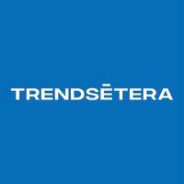
Functional Workload Deep Dive (20/20): Communication & Public Relation
Total Outsourcing Partners
Total Workflows Analyzed
Service Providers | Key Workflow
 | • Media monitoring and analysis reports • Content development and media pitching • Influencer engagement and community engagement
 | • German Coalition law revisions • Campaign strategy and implementation • Achievement of business objectives
 | • Campaign management • Monitoring and casting activities • Writing of influence briefs
 | • Contact with influencers • Execution of campaigns with brands • Creation of creative ideas for social media platforms
~ 4
~ 5
Share by Service Providers
Key Provider Locations
Greater Chicago Area, United States
Mexico City Area, Mexico
Paris Area, France
Singapore
Washington D.C. Metro Area, United States
Note: Service Provider share is based on the number of projects.

Slide 88
Key Executives
Chris Kempczinski President and Chief Executive Officer Greater Chicago Area, United States
Denise Hansen CFO, McDonald's Canada Toronto Area, Canada
Travis Foti VP, Chief Technology Officer ANZ Greater Sydney Area, Australia
Skye Baker Chief Development Officer Greater Sydney Area, Australia
Walid Fakih CEO at Emirates Fast Food Company - McDonald's UAE Dubai, United Arab Emirates
Erin Moore Chief People Officer Toronto Area, Canada
Melati Abdul Hai Senior VP - Chief Impact Officer Selangor, Malaysia
Korin Baruch Ketner Chief Marketing Officer Tel Aviv, Israel
Tiffanie Boyd Global Chief People Officer Greater Chicago Area, United States
Emanette Veronica Crisostomo Vice President and Chief Finance Officer Calabarzon, Philippines
Ian Borden Executive Vice President and Chief Financial Officer Greater Chicago Area, United States
Thomas Mosimann CfO Vaud Area, Switzerland
Note: Executives mentioned above are some of the key executives in the organization and not exhaustive.

Slide 89
Key Executives
Christy Allison Chief People Officer Amarillo, Texas Area, United States
Rajeev Goel Chief Financial Officer National Capital Region, India
Morgan Flatley Global Chief Marketing Officer & Head of New Business Ventures Greater Chicago Area, United States
Emma Napoli-Hala Chief People Officer Greater Sydney Area, Australia
Raza Ali Chief Marketing Officer Lahore, Pakistan
Vincent Choi Chief Development Officer Hong Kong
Hidehito Hishinuma Chief Restaurant Officer, Sr. VP Tokyo, Japan
Pat Myers SVP, US Chief People Officer Greater Minneapolis-St. Paul Area, United States
Ihsane Takhim Chief Information Officer Casablanca-Settat, Morocco
Max Chang Cto Taipei City, Taiwan
Kevin K. Chief People Officer Hong Kong
Barbara Asin Chief Marketing Officer Miami-Fort Lauderdale Area, United States
Note: Executives mentioned above are some of the key executives in the organization and not exhaustive.

Slide 90
Key Executives
Amy Kovalan Vice President and Global Chief Compliance Officer Greater Chicago Area, United States
Joe Chiczewski Chief Executive Officer, Australia & New Zealand Greater Sydney Area, Australia
Jamil Mughal Chief Operating Officer Karachi, Pakistan
David McMullen Chief Technology Officer Toronto Area, Canada
Joe Blum Ceo Moscow, Russia
Patrick johnson Ceo Toronto Area, Canada
张茜茜 Group Cfo Hong Kong
Mike VanderVeur COO Greater Atlanta Area, United States
Angelina Villanueva Chief Marketing Officer, Asia Business Unit Singapore
Michèle Boudria President & CEO, McDonald's Canada Toronto Area, Canada
Joe Rogan Ceo Kansas City Metropolitan Area, United States
Rob Delaney Chief Executive Officer Greater Los Angeles Area, United States
Note: Executives mentioned above are some of the key executives in the organization and not exhaustive.

